Slide 1
Journey to Success
Sadie Costello, PhD
October 19, 2018

Slide 2
Measures of disease occurrence
Prevalence
The proportion of a population with a specific type of disease at one point in time.
e.g., the proportion of children in a school who have a anxiety diagnosis on October, 19th 2018.
Incidence
The rate at which new cases of disease occur in a defined population over a period of time.
e.g., number of new cases of anxiety in a school between September 1 and October 19th, 2018.
2

Slide 3
Disease Incidence
Takes into account the factor of time
Can be used to judge whether there are changes in disease occurrence over time
Can be used to assess the effectiveness of public health interventions (e.g., water supply treatment)
Most useful in assessing causal associations between exposures and health
3

Slide 4
Cohort studies
Define a group of people and follow them in time to observe disease occurrence (incidence) in relation to exposure.
Prospective cohort studies
Retrospective cohort studies
Whether prospective or retrospective depends on where (in time) the investigator is situated.
4

Slide 5
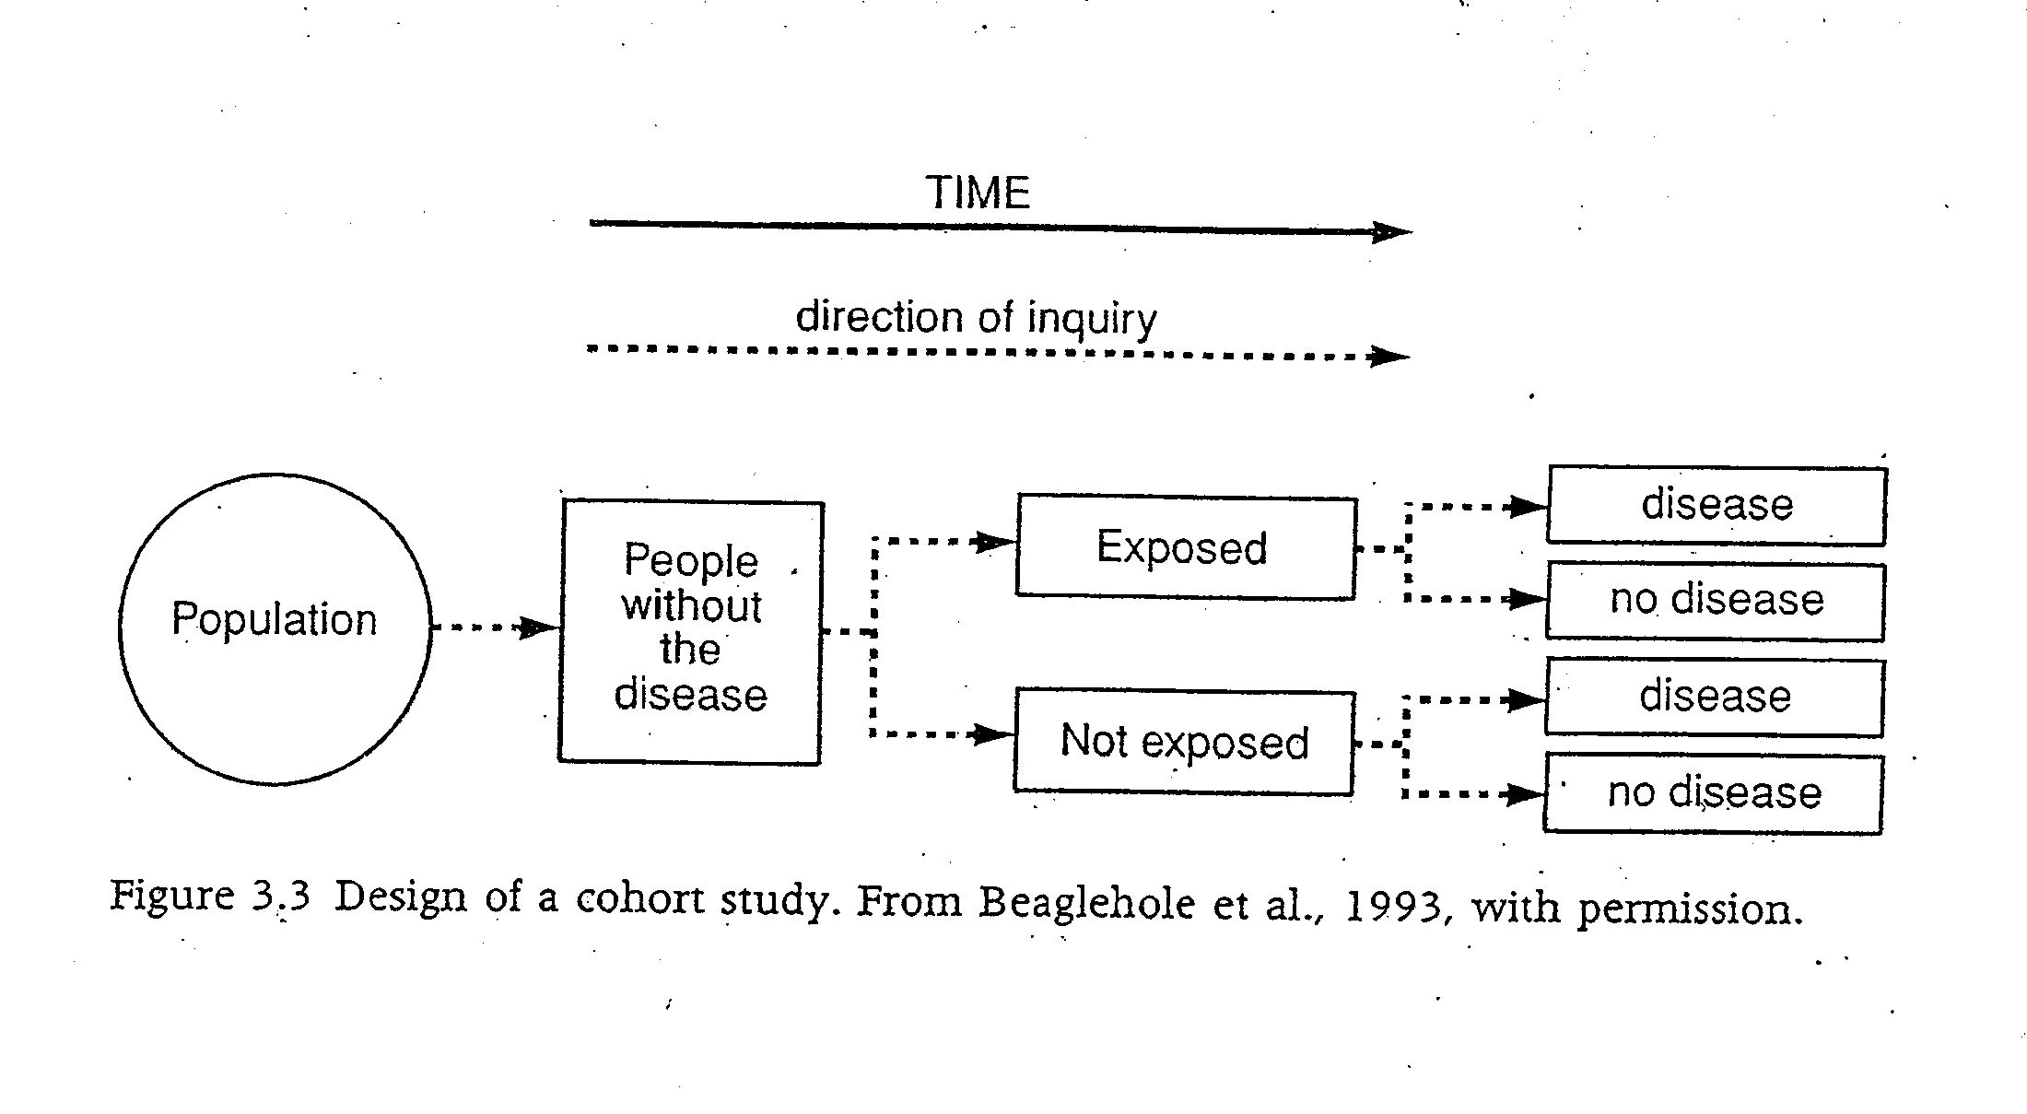
Prospective cohort studies
Investigator
begins study
here
5

Slide 6
Prospective cohort studies
Identify cohort, follow into the future and collect data on exposures and disease outcomes.
The “gold standard” in observational epidemiology
Can get high quality data
But can be very expensive and lengthy
Seldom done in environmental epidemiology
6

Slide 7
Retrospective cohort studies
Investigator
begins study
here
FIRST: Define Pop of Interest
7
7

Slide 8
Retrospective cohort studies
Much quicker and cheaper than prospective cohort studies
Can study many different causes of death/disease at the same time
More common in occupational epidemiology than in environmental epidemiology, because past-existing occupational groups can often be clearly identified
8

Slide 9
Statistics in brief
Land-use regression utilizes the monitored levels of the pollutant of interest as the dependent variable and variables such as traffic, topography, and other geographic variables as the independent variables in a multivariate regression model
Cox Proportional Hazards Model is a regression model for time-to-event outcome on one or more predictors. The Hazard Ratio is a ratio of the risks of getting the outcome given that the person has survived up until a specific time.

