Slide 1
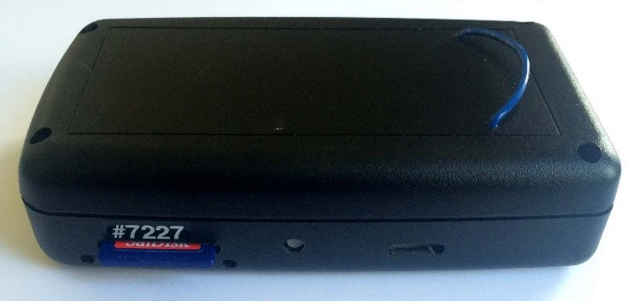
PATS+ Particle and Temperature Sensor
The PATS+ is a small, portable data logging device that measures real-time particle concentrations. Its specifications include:
Lower particulate matter detection limit is 10 to 20 μg/m3
Upper particulate matter detection limit is 30,000 to 50,0000 μg/m3
Internal, rechargeable battery with a run-time of ~72 hours
Also logs temperature and humidity with an option for movement and CO

Slide 2
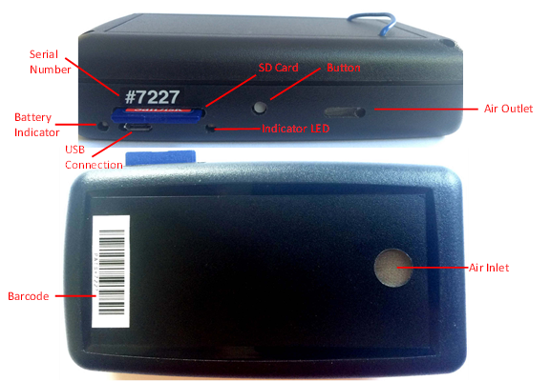
PATS+ Buttons and Symbols

Slide 3
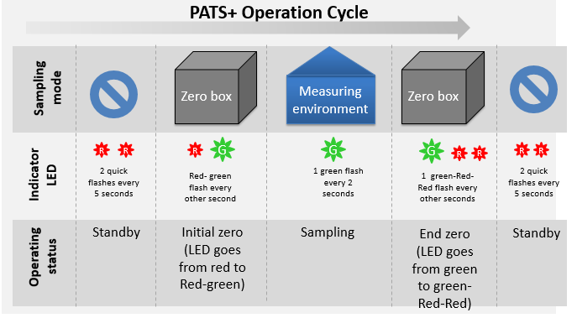
PATS+ Operation Cycle

Slide 4
PATS+ Operation
Programming the PATS+
Zeroing the monitor
Installing and uninstalling the PATS+
Downloading Data
Maintenance

Slide 5
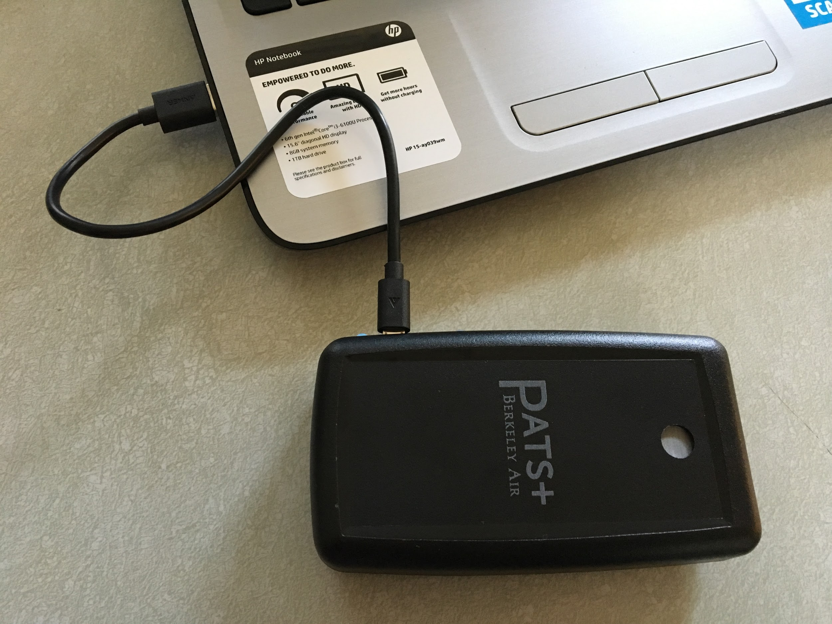
Programming the PATS+
Check that your computer clock time is accurate
Connect PATS+ device to the computer using USB micro cable – must be DATA cable, not only charging cable (make sure the SD card is fully seated).
Open PICA software and select the Launch page

Slide 6
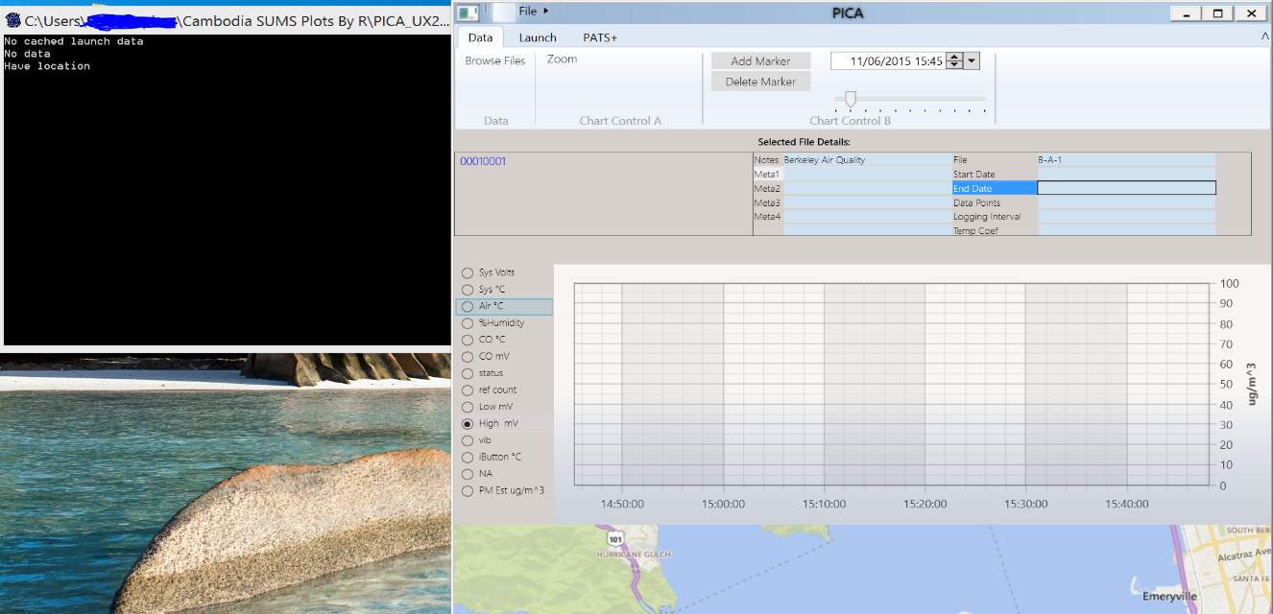
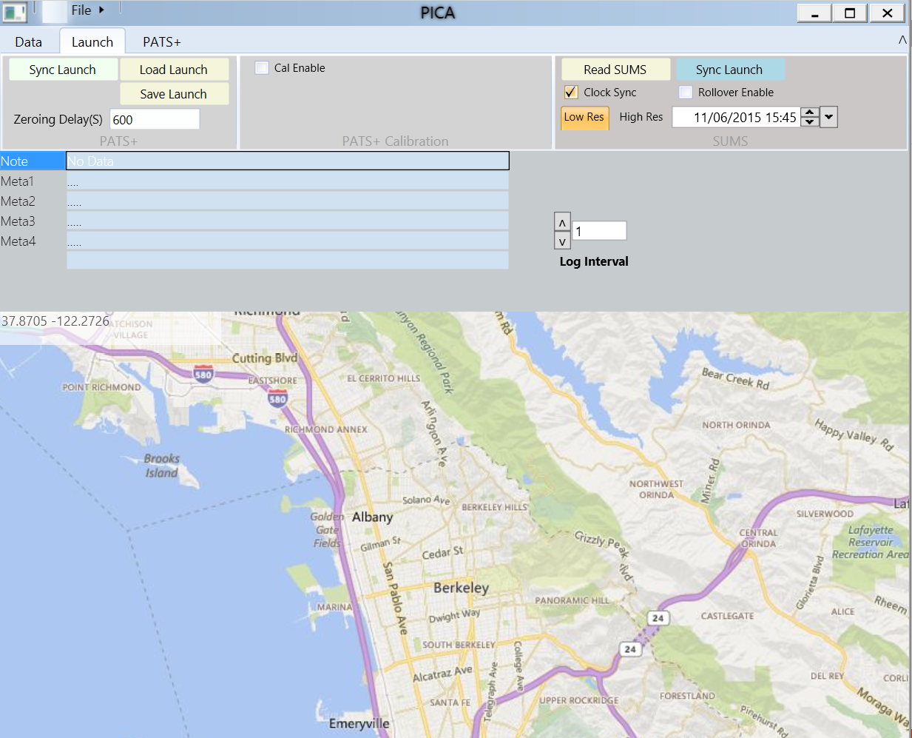
Programming the PATS+
Fill the data fields for reference notes. Such as ‘the project title’ or ‘household ID’.
Example:
Select the logging interval by clicking the up and down arrows (standard interval is 60 seconds) above the ‘log interval’ option.
Click the ‘Sync Launch’ button. (Can also “save launch” to apply to other devices later.
Disconnect the device from the computer. The PATS+ indictor LED will start flashing two red flashes to show it is in standby mode.
Log interval:
1 = 60 seconds

Slide 7
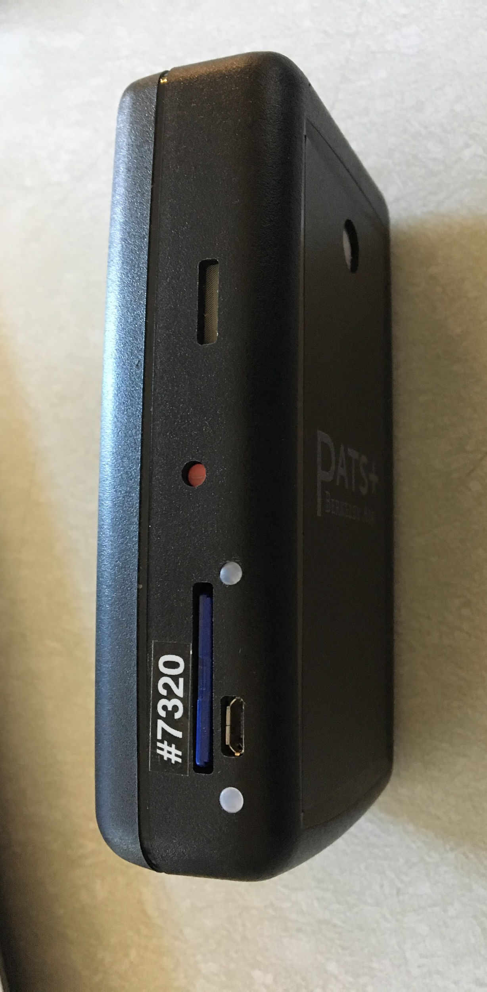
Zeroing the monitor
PATS+ must be in zero-particle environment for 10 minutes before sampling.
At the sampling location, find a clean, safe area out of direct sunlight.
Press and hold the PATS+ button until the LED changes from red to green and then release the button. Check if PATS+ indicator LED is flashing Red-Green every other second
LED indicator

Slide 8
Zeroing the monitor
Place it in the box with the intake hole exposed.
Repeat as quickly as possible for up to 4 PATS+ units
Close the box and pump 100 squeezes of air into the box using the squeeze pump.
After 10 minutes (or when you see that the PATS+ lights are flashing green once every other second) open the box and check that the light is flashing green every two seconds. It is now in sampling mode.

Slide 9
Installing and uninstalling the PATS+
Install the PATS+ as required for the given sample.
In the case of the kitchen sample, it should be ~1.5 meters from the ground, 1.0 meter away from the stove’s combustion zone, and at least 1.0 meter from open windows and doors (if possible). Make sure that the PATS+ is secure. The PATS+ should also not interfere with the participant’s activities.
For personal sampling, put the PATS+ in the armband and explain to the participant that he or she can remove it when sleeping, bathing, or doing other activities for which it is not possible to wear the device. Fit the armband to the participant and show him or her how to adjust and remove it.
Connect the PATS+ to a USB power bank if needed.
Record placement and start time.

Slide 10
Installing and uninstalling the PATS+
At the end of the sampling period, remove the USB power bank if attached, then press the button and hold it until the LED changes from red to green, then release the button. The flashing green-red-red LED every other second indicates that the end zeroing period has started, immediately put the device in the zero box for the end zeroing period.
After the end zeroing period, the LED will start flashing double red and it can be taken out of the box.

Slide 11
Downloading Data
Connect the device to the computer using USB micro cable.
Open PICA software.
Right click on the filename which you want to download from the Pats+ page.
You should see the graph and the selected file details updated.
Then click on the Data tab, you should have the file you selected from the Pats+ page.
To download the file, click the ‘Export to CSV File’ button.
Select a location where you want to save the file.
Then click the ‘save’ button and the file will be saved at the selected location.
Rename the file as needed.
After each day of data is downloaded, turn the entire file into a zip file and email to the project manager.

Slide 12
Maintenance
It takes approximately 4 hours to charge a fully depleted PATS+. When PATS+ is first connected to a charger, the LED indicator will be red pulsating and will start flashing double red, once it’s fully charged.
If the baseline photoelectric signal increases over 100 mV, it is recommended to clean the PE chamber. In a clean environment, remove the enclosure by unscrewing the 4 side screws. Use the hand squeeze pump to clean the chamber. 40-50 pumps into the chamber at different angles are recommended.
When not in use, store the PATS+ in plastic bags in a clean, dry location with the SD cards unseated.

Slide 13
Questions?

Slide 14
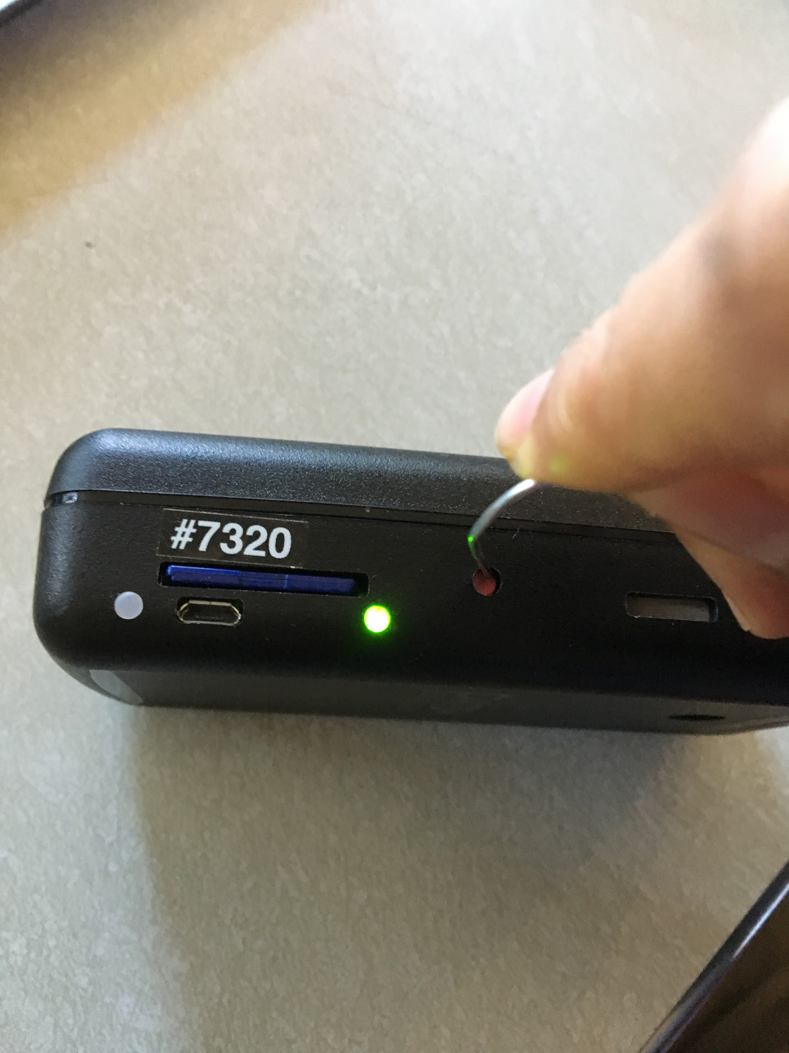

Slide 15
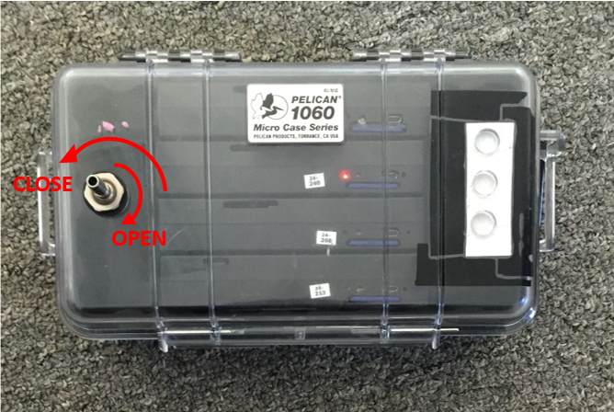
Notes:
15

Slide 16
CLOSE
OPEN

