Slide 1
The Gaps in Between
Truth, Praxis, Structural Violence and Hope

Slide 2
Murmuration
Notes:
https://www.youtube.com/watch?v=eakKfY5aHmY

Slide 3
K weird...bye.
Lolz
Notes:
Some of you are already on to it and some of you are like uuuuuuuhhhhh, orly?!
BUT, some of you are already starting to get it.
Starling Murmuration: Unity, collaboration, common good, agility

Slide 4
Journey!
WHY
Recentering humanness
Seeking truth and inclusion
Engagement as humanness
Engagement as pursuit of stronger truth
What
CBPR
YPAR
Praxis and YOU

Slide 5
Science as speaking, naming, and truth
“Human existence cannot be silent, nor can it be nourished by false words, but only by true words, with which men and women transform their world. To exist, humanly is to name the world, to change it. Once named, the world in its turn reappears to the namers as a problem and requires of them a new naming. Human beings are not built in silence, but in word, in work, in action-reflection. But while to say the true word- which is work, which is praxis- is to transform the world, saying that word is not the privilege of some few persons, but the right of everyone. Consequently, no one can say a true word alone – nor can she say it for another, in a prescriptive act which robs others of their words."
- Paulo Freire
Notes:
Silence -> true words and nourishment -> transformation -> to change is to truly exist as a human (both reaffirming human meaning/dignity and focus on impact).
Word -> Work -> Action-reflection (reflexive and iterative) PRAXIS: “to transform the world”
No one can say a true word alone, nor can she say it for another -> participatory, democratic (democracy is supposed to mean equitable participation, equitable impact and equitable burden) -> flat hierarchies (in time)

Slide 6
Take a breath and reflect
Notes:
Close eyes for 20 seconds
Celebrate all the awesome ideas you worked with and the project you have labored on!
Cherish the importance of a multidisciplinary and experientially driven project like this
Take nourishment from the humanness of the work you are engaging in

Slide 7
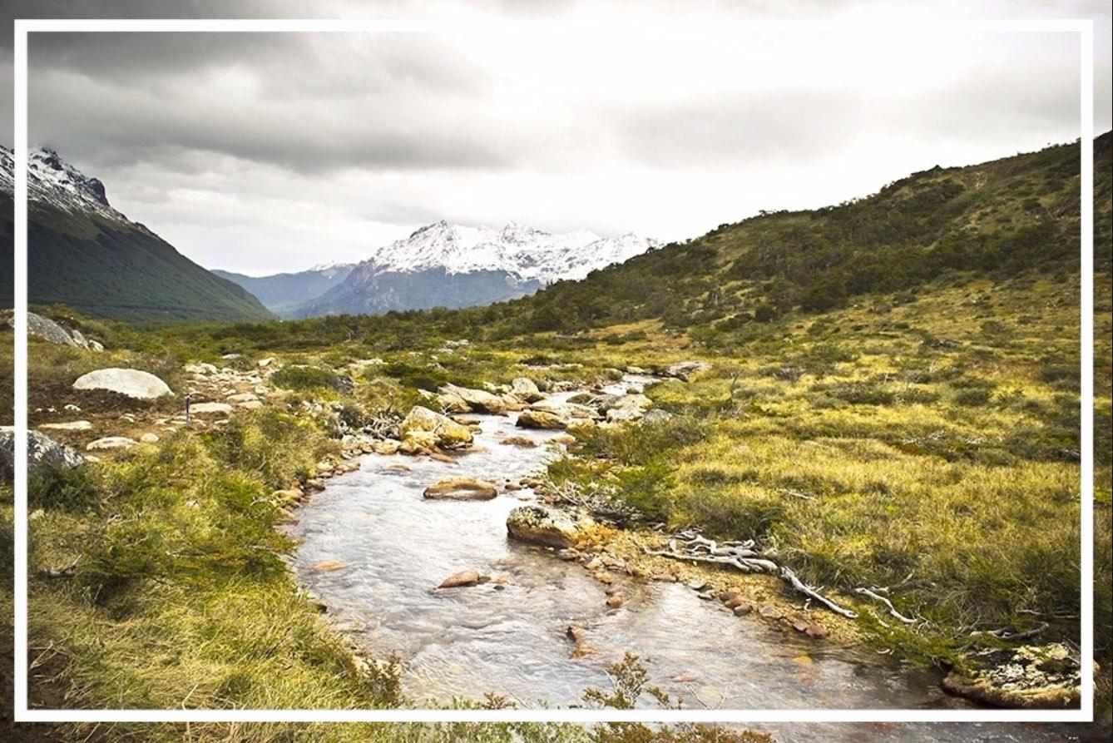

Slide 8
Take that centering with you to address the challenges

Slide 9
Structural Violence
“Violence (the prevention of individuals or populations from reaching their mental and physical potential) without a specific actor committing the violence; when “violence is built into the structure and shows up as unequal power and consequently as unequal life chances.” It may be unintended and indirect.”
-Johan Galtung, Journal of Peace Research 1969
Notes:
Helena Hansen, Structural Competency PPT

Slide 10
“Suffering…‘structured’ by historically given (and often economically driven) processes and forces that conspire—whether through routine, ritual, or, as is more commonly the case, the hard surfaces of life—to constrain agency.” For example, “choices both large and small are limited by racism, sexism, political violence, and grinding poverty”
Paul Farmer, Daedalus 1996
Notes:
Helena Hansen, Structural Competency PPT

Slide 11
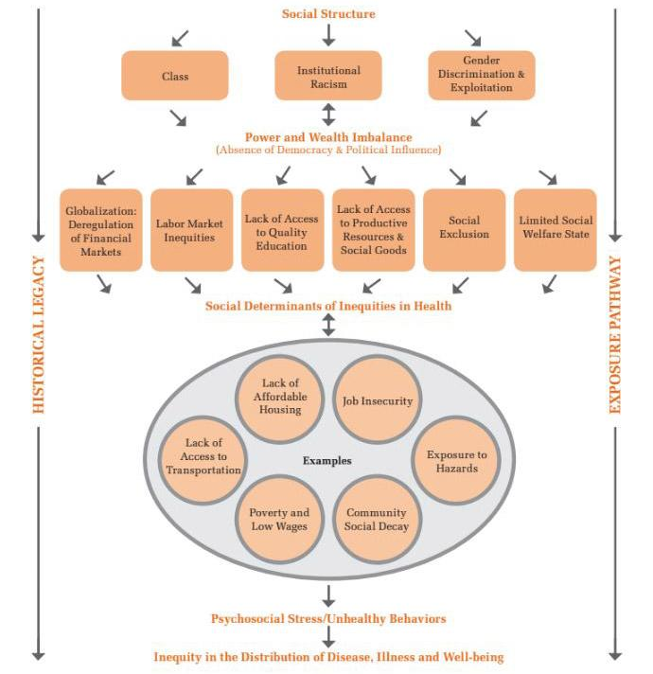
Social Injustice
and
Health Disparities

Slide 12
Invisibilization
Of
Power

Slide 13
Notes:
- Beached ships in Patagonia: potential challenges w/ overfishing, large scale fishing vessels, market saturation
- Shells of abandoned boats in a remote area, far away from where people do their daily activities
- Sometimes its not what one sees, its what one doesnt see and doesnt know they should see

Slide 14
Historical

Slide 15
Standard Oil, 1910
Notes:
Chevron as it is now known, began in Richmond in 1902
In “1945, the Richmond Refinery won its fifth U.S. Army-Navy “E” award for its support of the military effort”
Epigenetics and intergenerational health/ Wealth

Slide 16
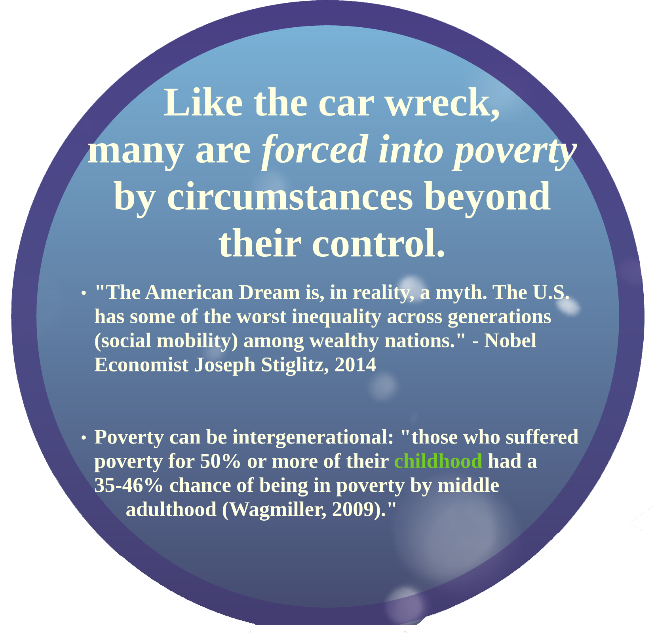

Slide 18
Embodied

Slide 19
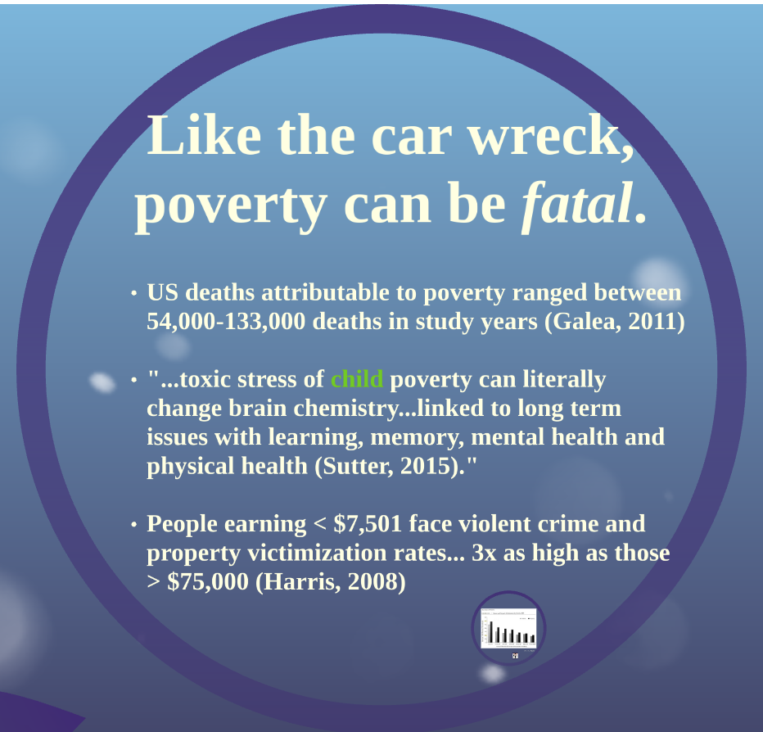

Slide 21
Compounding

Slide 23
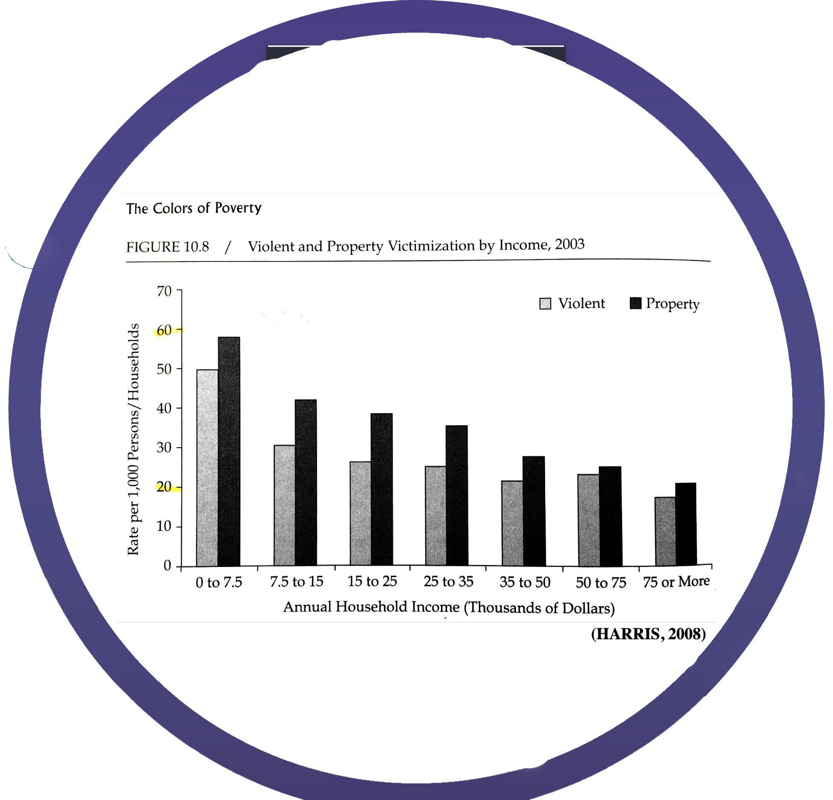

Slide 24
¯\_(ツ)_/¯
Inaction compounds pre-existing power structures (inequities)
Notes:
“the meaning of the “the shruggie” is always two, if not three- or four-, fold. ¯\_(ツ)_/¯ represents nihilism, “bemused resignation,” and “a Zen-like tool to accept the chaos of universe.” It is Sisyphus in unicode.” - Robinson Mayer, Atlantic https://www.theatlantic.com/technology/archive/2014/05/the-best-way-to-type-__/371351/
Its natural to face huge challenges and want to step back or look in the opposite direction:
See ugliness -> seek beauty or “shiny things” -> Bourdieu's “habitus”

Slide 25
Distraction dillutes praxis

Slide 27
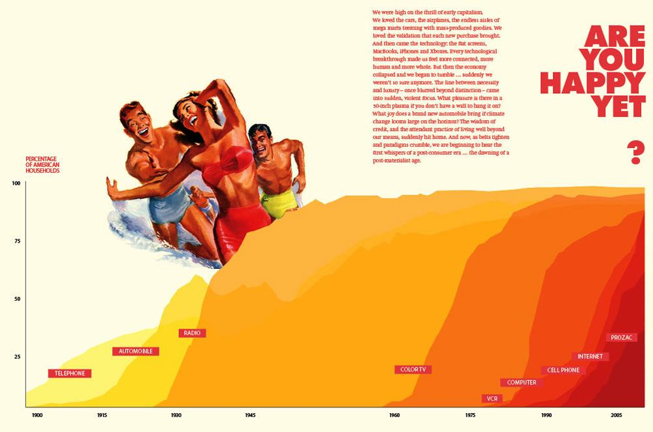
Adbusters

Slide 28
Attention (focus) as commodity
Constant streams of content depict utopian existence
Unattainable utopia as “constructed” product which can be bought/sold for profit
Notes:
Its really really easy, especially now, to just ignore things that are confusing or dont immediately align with our personal priorities.
Sometimes, as humans, its very tempting to focus on the next vacation or next pair of shoes rather than the climate and social impact of the jetliner and of the shoe factory.
Staying focused on what matters is CRITICAL
Companies are literally buying people's attentions (or a higher probability of capturing it)
Attention is used to generate $$ instead of meaningful action (PRAXIS)

Slide 29
S o l u t i o n s
simple words for complex praxis

Slide 30
Reflexivity and starting with self
Please take 15 minutes to complete you Personal Narrative worksheet

Slide 32
Taking time to disconnect from social media and everyday drama
Spend time in nature
Spend time with family/friends
Make new friends outside of your normal circles

Slide 33
Act in such a way that your action can be universalizable
Make each act an end in itself, and a means to another end, both for yourself as actor and the person affected
Notes:
Everyone cant buy everything all the time
Buying is like our vote, it reflects values in a system that is sometime even more responsive and agile than government
Buying is still not true praxis, it doesnt enage our own humaness
Categorical imperative and Immanuel Kant

Slide 34
Intent
Almost everyone thinks of them as a “good person”
Take 3 minutes to write about what a “good person” is

Slide 35
Impact
What did you write? What makes a person “good”?
How does this person act?
Who is impacted the most?
Was that person ever asked for their perspective?
Notes:
Everyone thinks they are a good person
Constructed version of self based on an image
Less often measured by actions
Actions less often have measurable impact
Even less frequently are those who are impacted consulted
And even LESS frequently are those impacted actively engaged and supported in addressing the issue

Slide 36
Action requires recentering ourselves
Action then requires recentering folx who face the most harm
Sustainable action requires incorporating diverse perspectives simultaneously

Slide 37
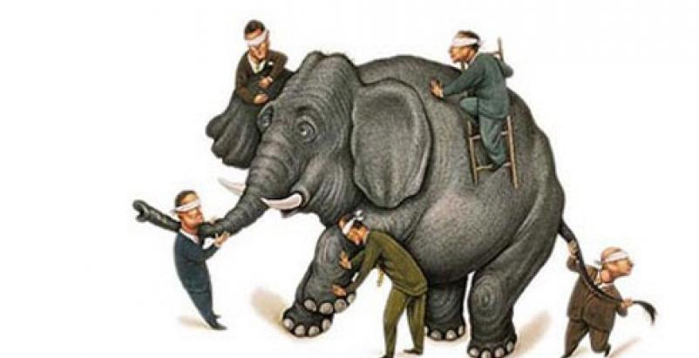
Objectivity as Construct
Notes:
What does each blindfolded person know about the elephant?
How does the challenge of the blindfold, in a way, become a strength?
How can each perspective best be harnessed to unveil a stronger truth of the elephant?

Slide 38
Standpoint Theory
Often, power functions via invisibility so many privileged folx dont see their power or how it impacts marginalized folkx
Idea that those who face most oppression often have the most nuanced understanding of its function and impact
These people, therefore are key to identifying innovative and efficient solutions
Because dominant structure is so expansive, marginalized often have a dual (and multiple) consciousnesses that can be tapped to navigate complex situations
Notes:
Ex. seeing the horizon in the sea, or seeing one wave in a storm
Patricia Hill Collins
Wikipedia!

Slide 39
Strong Objectivity
All people are subjective, therefore claiming objectivity invisibilizes bias
Embraces and incorporates multiple perspectives (lenses)
Develops mechanisms for balancing/ controlling for biases
Include reflexivity and examining positionality
Notes:
Sandra Harding, known for her work on feminist standpoint theory. Harding suggests that starting research from the lives of women "actually strengthens standards of objectivity".^{[1]}
Wikipedia!

Slide 40
Praxis from a place of privilege: a paradox?
Those with the most privilege also often are implicitly the cause of some harm (usually indirect and embedded in structural inequities, ex. artificial scarcity)
Those with the most privilege are also often best equipped to instigate large level change!
Yet, those who face the most burden often also have the greatest incentive to innovate and act
Survival tactics require deep understanding of context and the rules of the game -> can help inform strategic areas/platforms for intervention
Creating paid positions with marginalized folx is key but the burdens of the struggle need to be equitably distributed
Notes:
Maximum impact & minimum effort (work smart not hard)
Perfect = Enemy of good

Slide 41
Cultural Competence -> Humility
Openness to:
Long term dialogue and relationships
New ideas that dont align with your own
New ways of thinking
Alternative value systems
Being uncomfortable AND enjoying new things
Holding space
Not being the center of attention/leader/expert
Flexibility with time/space
Being an advocate in spaces of privilege ->
Being a conduit for influential people to expand their perspectives
Notes:
Competence: yet another subject that a researcher can become an expert in and master
Pub H. “Competence” failures: ex. White hazmats in Angolan ebola outbreak; mosquito nets reused as fishing nets
Humility: dialogue, inquiry, holding space

Slide 42
Function:
Community Based Participatory Research
Relevance
Rigor
Reach
Notes:
Ask youth to explain these functions
The Three R's: How Community Based Participatory Research Strengthens the Rigor, Relevance and Reach of Science. (Balazs CL1, Morello-Frosch R)

Slide 43
Structure:
1. Recognizes community as a unit of identity.
2. Builds on strengths and resources within the community.
3. Facilitates a collaborative, equitable partnership in all phases of research, involving an empowering and power-sharing process that attends to social inequalities.
4. Fosters co-learning and capacity building among all partners.
5. Integrates and achieves a balance between knowledge generation and intervention for the mutual benefit of all partners.
Notes:
http://www.policylink.org/sites/default/files/CBPR.pdf

Slide 44
6. Focuses on the local relevance of public health problems and on ecological perspectives that attend to the multiple determinants of health.
7. Involves systems development using a cyclical and iterative process.
8. Disseminates results to all partners and involves them in the wider dissemination of results.
9. Involves a long-term process and commitment to sustainability.
10. Openly addresses issues of race, ethnicity, racism, and social class, and embodies “cultural humility.”
11. Works to ensure research rigor and validity but also seeks to ”broaden the bandwidth of validity” with respect to research relevance.
Notes:
http://www.policylink.org/sites/default/files/CBPR.pdf

Slide 45
Notes:
http://www.policylink.org/sites/default/files/CBPR.pdf

Slide 46
Youth Participatory Action Research
Win-Win-Win-Win-Win-Win-Win-Win-Win
Harness experiential expertise
Amplify to silenced groups
Create high prestige job opportunities (+ job preparedness)
Low cost per person (though often less productivity)
Create supplementary edu opportunities
Facilitate college application process and transition
Innovative new ideas
Disarming as presenters
“Social opportunities to live out values”

Slide 47
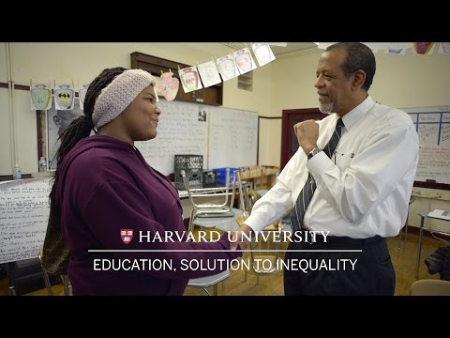
Notes:
Edu as conduit to emancipation

Slide 48
Key Facets of Engaged Praxis
Reframe “bad” and “good” within contexts that help explain root causes
Focus on facilitation rather than supervision/boss/leader roles
Focus on harnessing experiential expertise “universal in specific” (Patricia Hill Collins)
Focus on community assets and leveraging existing strengths (avoid problematizing and perpetuation of sensationalization)
Notes:
Bad/good: ex. Fast food as “bad” food and “personal choice” -> food desert, low income, low effort, limited time/competing obligations, increased likelihood that employee is from similar background
Challenges > Problems -> seek “both/and” win-win solutions and avoid “good/bad” “either/or” over simplications

Slide 49
If humanness isn’t enough…
there’s also a good ROI

Slide 50
W o n d e r

Slide 52
H o p e

Slide 54
Remember
WHY

Slide 55
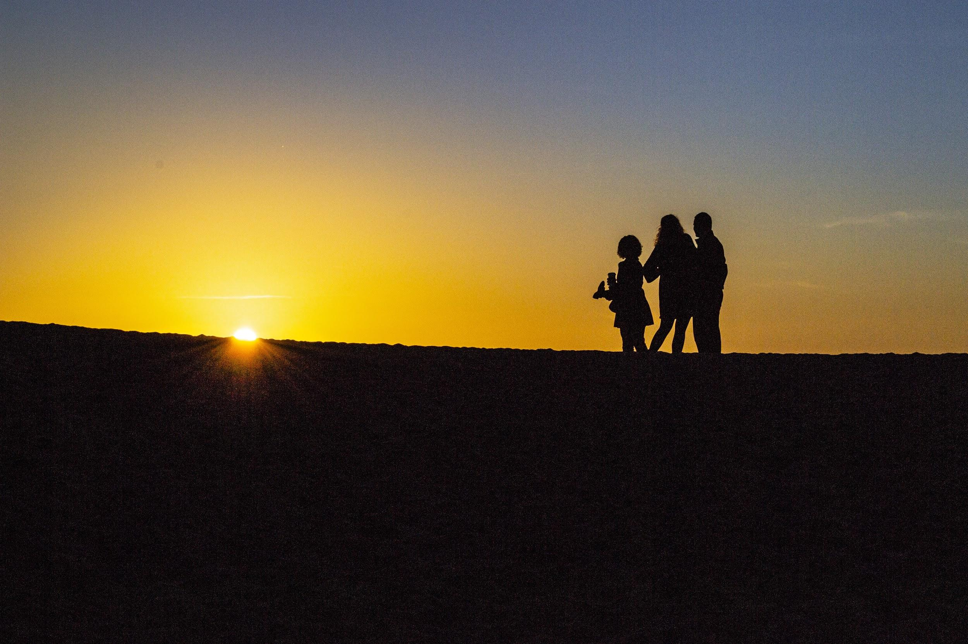

Slide 56
Break

Slide 57
Personal Narrative: Centering your Story
Take 10 minutes to complete your Personal Narrative worksheet
Pay special attention to the ways that your answers are framed within:
Environmental health
Social determinants of health
Air quality
Pursuit of “truth”
Geography/Location
Time/ History
Privilege

Slide 58
Mock Interviews
Pair up with someone you are most comfortable with
Together, imagine if you could only ask a key AQ stakeholder 5 questions, what would they be?
Add these questions to your personal reflection googledoc
Take 10 min to thoroughly answer the questions, pretend as if you were a person who was deeply passionate about the topic! Integrate aspects from your Personal Narrative
One of you will be interviewer, the other the interviewee
After, interviewers provide feedback:
How clear were points made/ did you learn about the key issues and facets of AQ? Were points missing?
Was there a clear human interest/narrative/story?
Did the interviewee provide action steps? Were they feasible?

Slide 59
Switch and repeat:
Interviewer asks questions, interviewee answers as if they were an expert, deeply engaged in community air quality issues
After, the interviewer will provide feedback:
How clear were points made/ did you learn about key issues and facets of AQ? Were points missing?
Was there a clear human interest/narrative?
Did interviewee provide action steps? Did they seem feasible?
Take 5 minutes to make updates and edits to your personal answers
Repeat the interview. This time audio record your partner (use voicememo etc, headphones/bluetooth if possible or hold very close to person)

