Slide 1

Liza Lutzker, Mph
June 21, 2018

Slide 2
Medicine vs. Public Health
Medicine | Public Health
TREATMENT of disease & injury | PREVENTION of disease & injury
INDIVIDUALS | COMMUNITIES & POPULATIONS

Slide 3

The Parable of the River

Slide 4
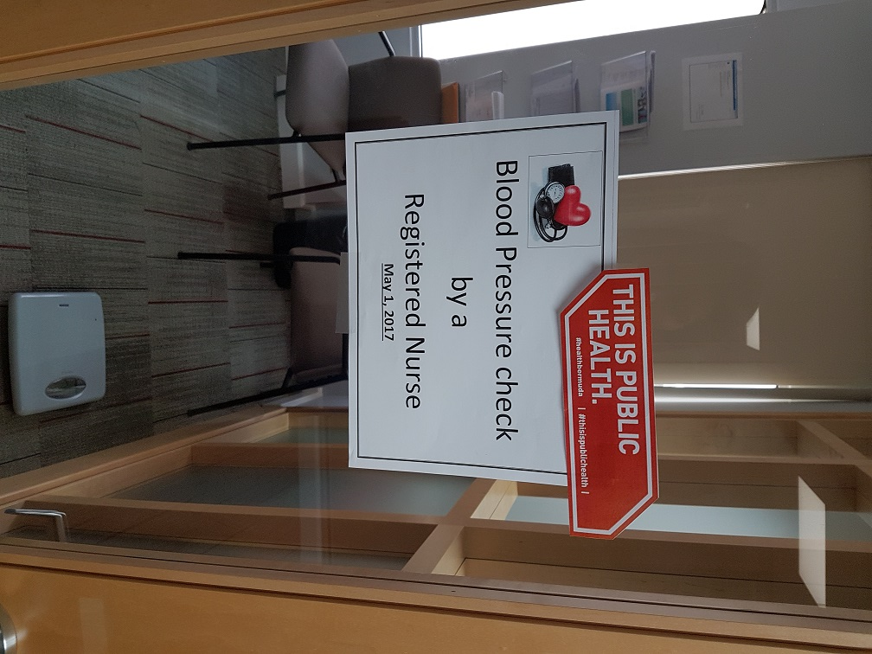

Slide 5
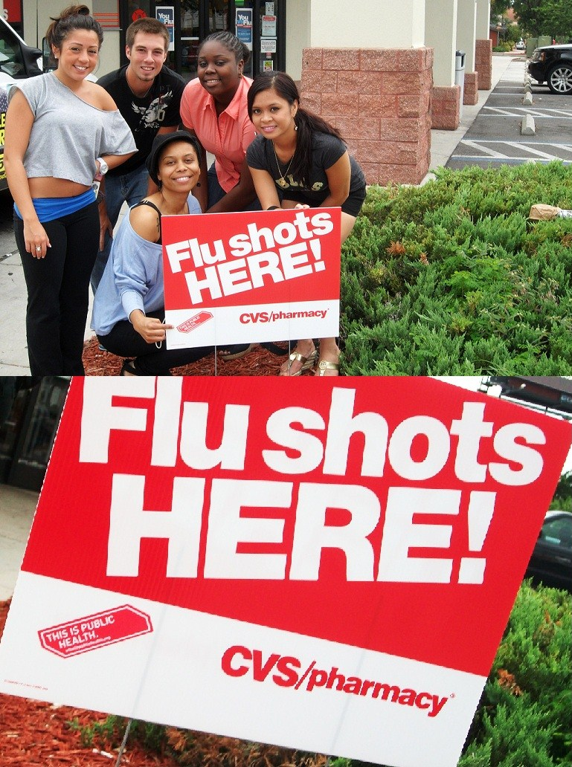

Slide 6
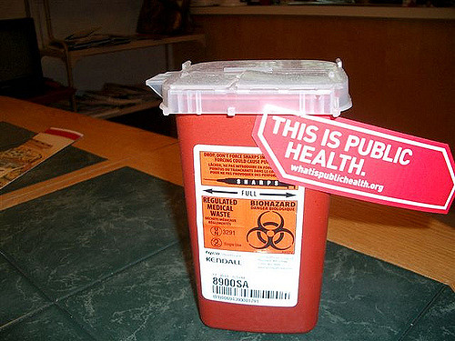

Slide 7


Slide 8
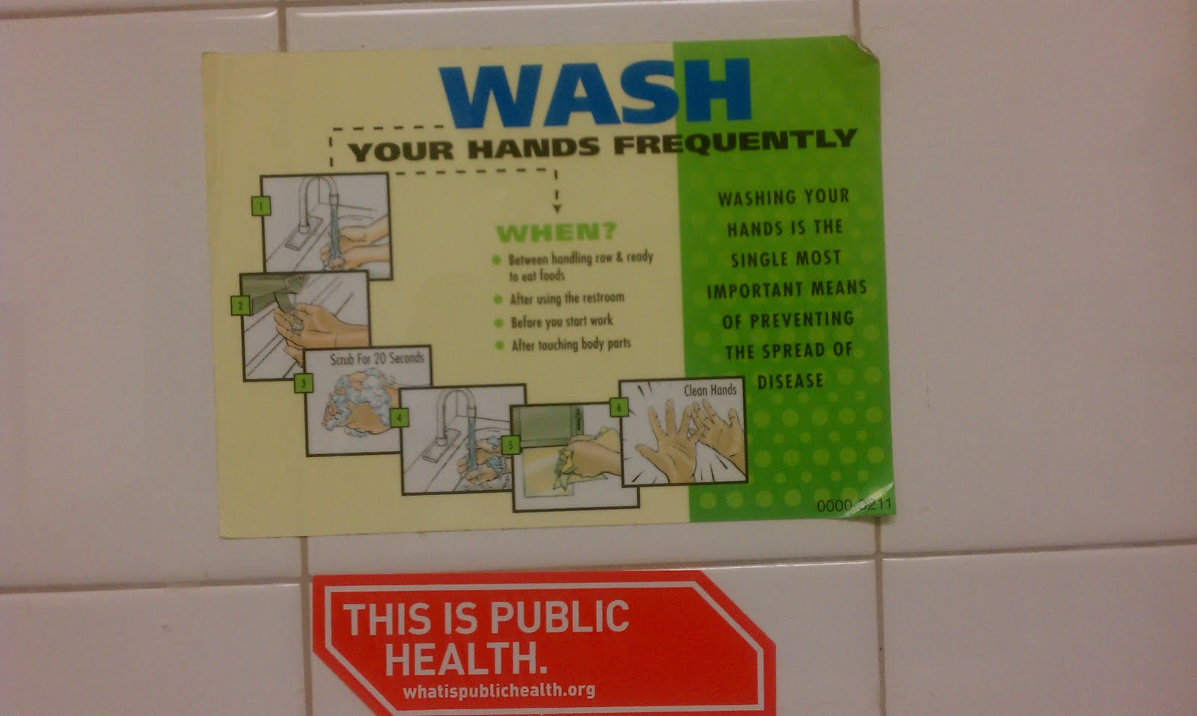

Slide 9
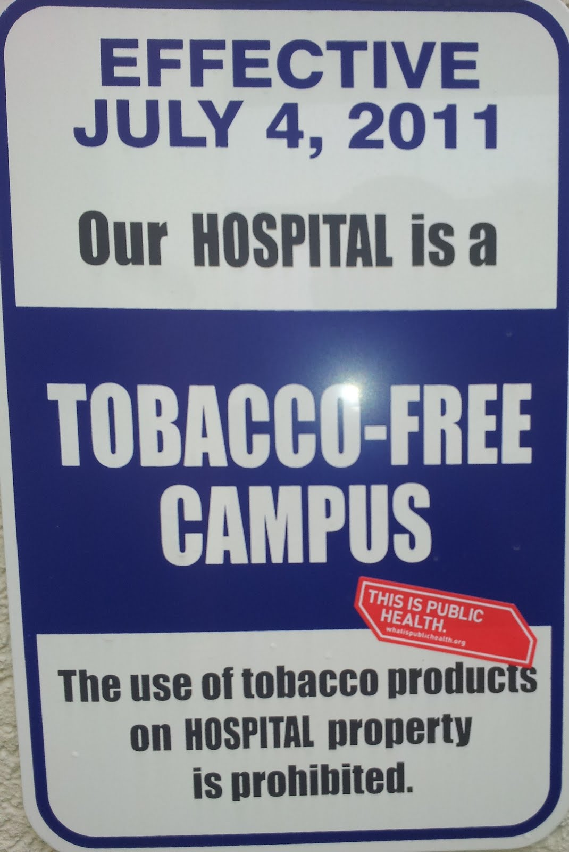

Slide 10


Slide 11


Slide 12


Slide 13
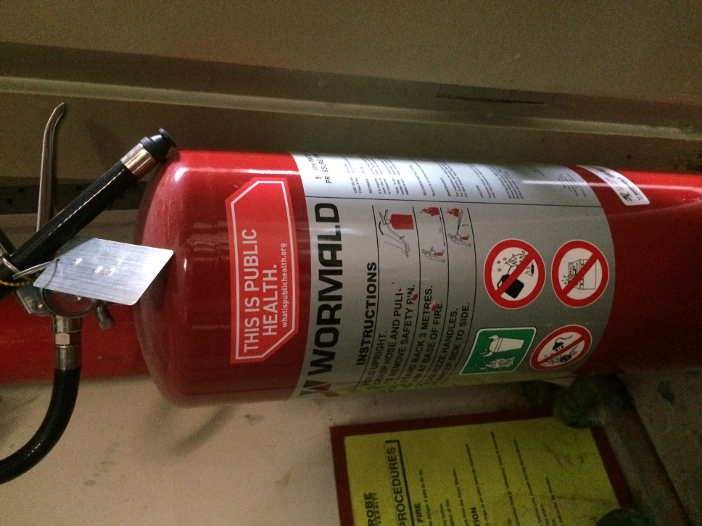

Slide 14
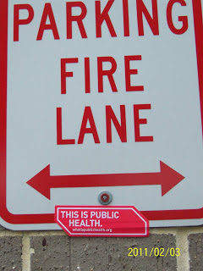

Slide 15
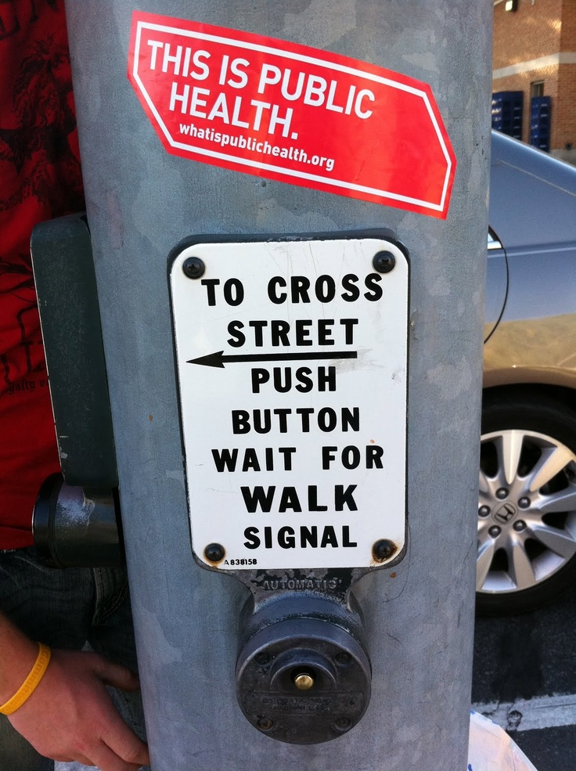

Slide 16
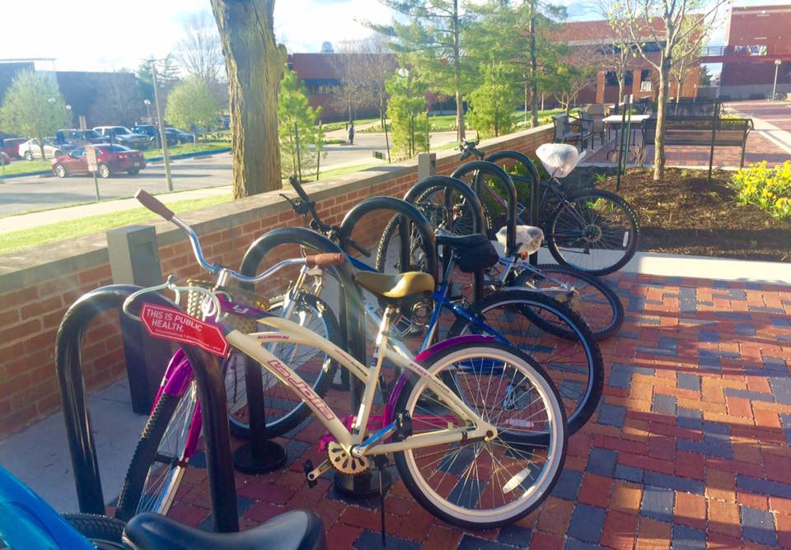

Slide 17
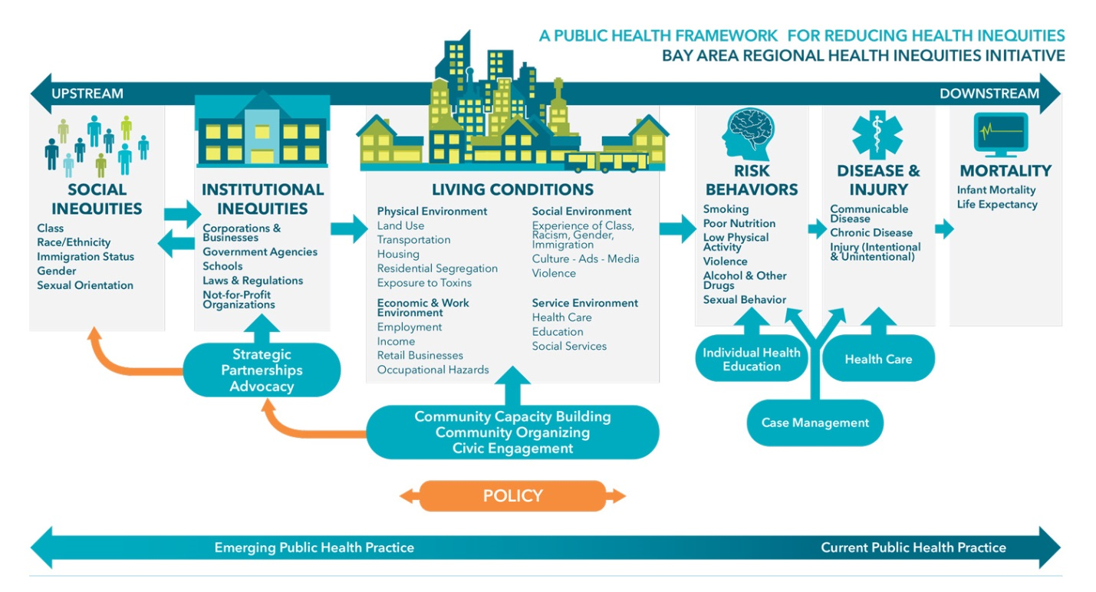
The Social Determinants of Health

Slide 18
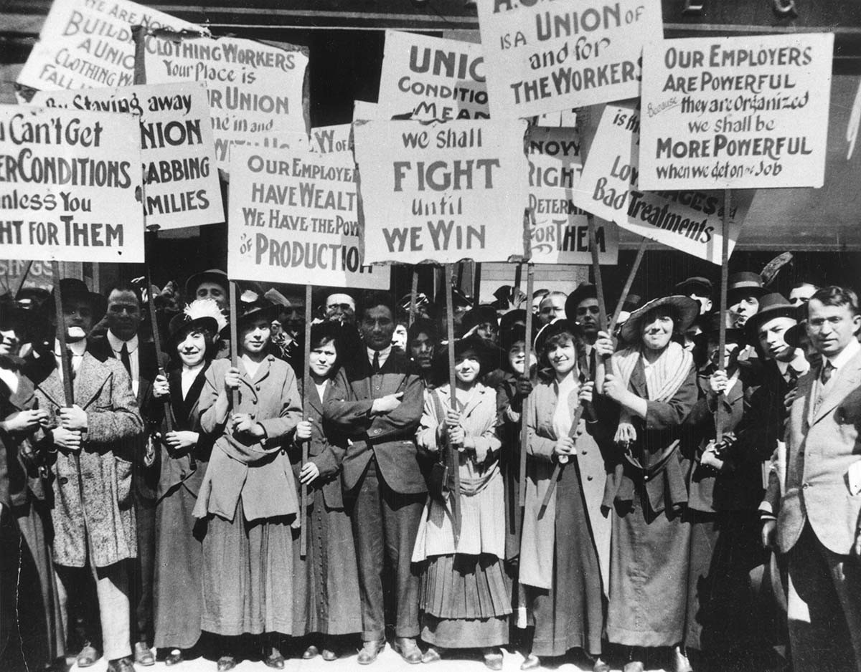
Upstream: Labor Unions

Slide 19
Upstream: Labor Unions
(excerpt from American Public Health Association’s Policy Statement on Labor Unions and Health)
Having recognized the detrimental effects of unemployment and poverty on the public’s health; and
Realizing further that the health status of populations is determined in large degree by income and living standards; and
Noting that one of the primary motivations for development of the United States labor movement was to improve the safety of working conditions; and
Recognizing that union efforts to increase living standards of members has a positive effect on living standards of all workers; and
Noting that the decline in the number of unionized workers over the past 20 years has been associated with a decline in average real wages for working people in this country; and
Realizing that the defense of health care benefits for workers is critical to maintaining access to health care; therefore
Supports the right of all workers to organize and bargain collectively as a means of improving health and safety in the workplace and assuring broader access to health care coverage.

Slide 20

Upstream: Black Lives Matter Movement

Slide 21
Upstream: Black Lives Matter Movement
Though the Black Lives Matter movement started as a response to police brutality against African-Americans, its philosophy has grown to encompass all the ways in which people who identify as black/African-American are being injured. This includes inequality when it comes to health.

Slide 22
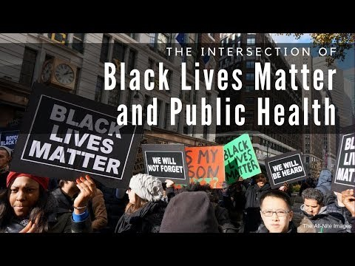
Upstream: Black Lives Matter Movement
https://www.youtube.com/watch?v=0okQj012bhg

Slide 23
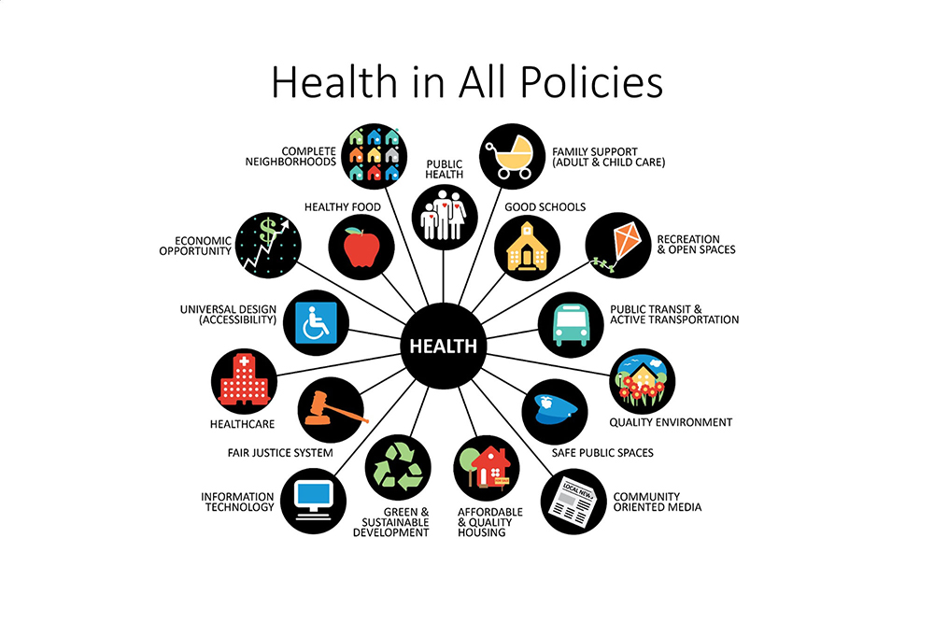
Health in ALL Policies (HiAP)
Based on the premise that good health is fundamental for a strong economy and vibrant society
AND
That health outcomes are largely dependent on the social determinants of health, which in turn are shaped primarily by decisions outside of the health sector

Slide 24
Made up of the following State of California departments, agencies, and offices:
Air Resources Board Office of the Attorney General Business, Consumer Services, and Housing Agency Dept. of Community Services and Development Dept. of Corrections and Rehabilitation Dept. of Education Environmental Protection Agency Dept. of Finance Dept. of Food and Agriculture Dept. of Forestry and Fire Protection Dept. of General Services | Government Operations Agency Health and Human Services Agency Dept. of Housing and Community Development Labor and Workforce Development Agency Natural Resources Agency Dept. of Parks and Recreation Office of Planning and Research Dept. of Social Services Dept. of Transportation Office of Traffic Safety Transportation Agency

Slide 25
California HiAP Achievements
Development of the Task Force Action Plan on Active Transportation
  Commitments from over 20 state departments and agencies to promote safe walking, biking, and public transit as a cross-government goal.
Food Procurement Working Group
  Integration of health criteria into State food purchasing contracts used by the Department of Corrections and Rehabilitation
Multi-agency workgroup to promote healthy environments through school facilities

