Slide 1
Journey to Success
Sadie Costello, PhD
September 21st, 2018

Slide 2
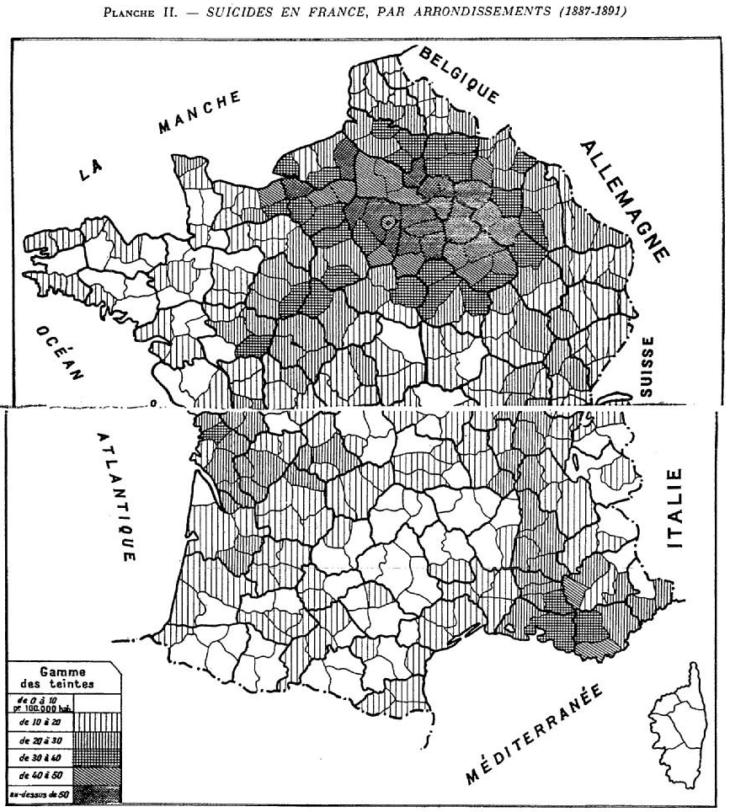
Durkheim 1966
What was causing suicide rates in France?
Religious affiliation
Ecologic Study
Used rates of Protestants and Catholics in each province to predict rates of suicide

Slide 3
Ecologic Fallacy
Findings: provinces with greater proportions of Protestants had higher suicide rates than Catholic provinces in France (Durkheim 1966)
Concluded: Protestants more likely to die from suicide than Catholics
May have actually been Catholics in predominantly Protestant provinces who were dying from suicide
Ecologic Fallacy: Making an inference about individual level suicide patterns based on proportion of suicides in provinces

Slide 4
Confounding
Caused by a variable that
1) is a risk factor for the outcome
2) is a predictor of the exposure
Or at least is not caused by the exposure
Start with list of risk factors for outcome
Then consider causal relation with exposure
Evaluate the factors the authors controlled for

Slide 5
Misclassification
Exposure
What was exposure of interest?
How well was it measured?
Never perfect
Was it measured better/worse for the cases?
Outcome
What was the outcome of interest?
How well was it measured?
Never perfect
Was it measured better/worse for exposed?
For this paper – was the outcome measured differently by region?

Slide 6
Suicide rate
Number of suicides in a week
Total population at risk in same week
X 10 million

