Slide 1
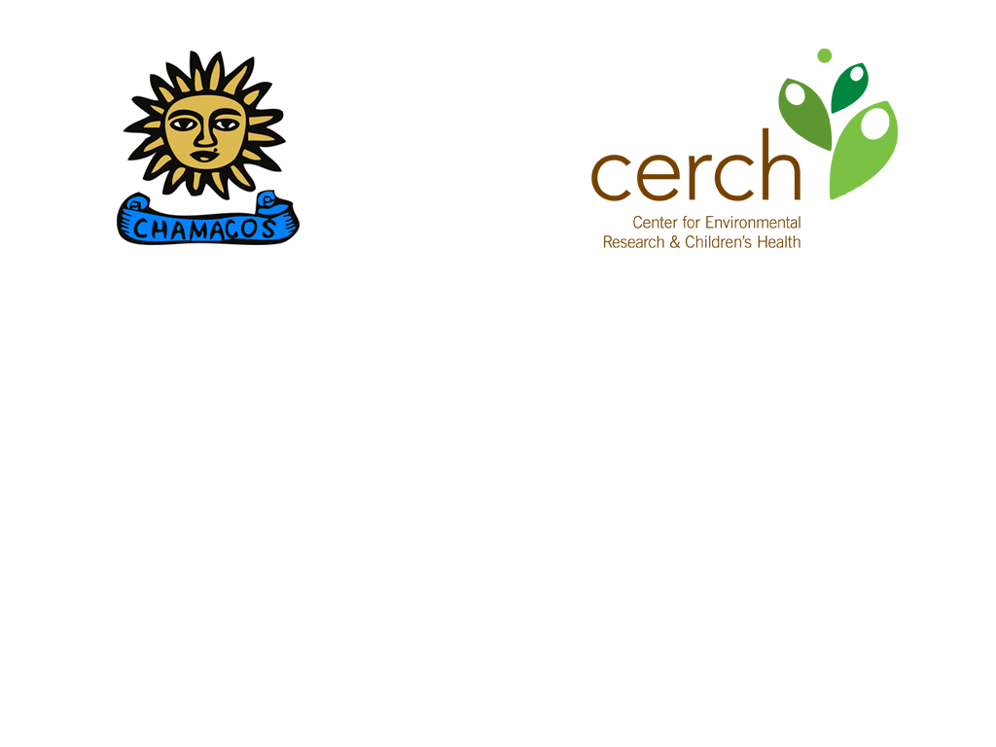
Ethics Matters in Environmental Health
Asa Bradman
Center for Environmental Research and Children’s Health (CERCH)
School of Public Health, University of California at Berkeley
June 26, 2018

Slide 2
Today’s Talk
Eugenics as a framework for unethical science
Examples of unethical conduct
Evolution of ethical guidelines for research
Current Critique
Case studies
  Human exposure studies
  CHAMACOS community-based research
  Questions for discussion

Slide 3
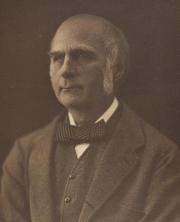
American Eugenics Society
Eugenics is the science which deals with all influences which improve the inborn qualities of a race; also with those which develop them to the utmost advantage.
Sir Francis Galton, 1904
http://wellcomelibrary.org/content/2843/23971/francis-galton.jpg

Slide 4
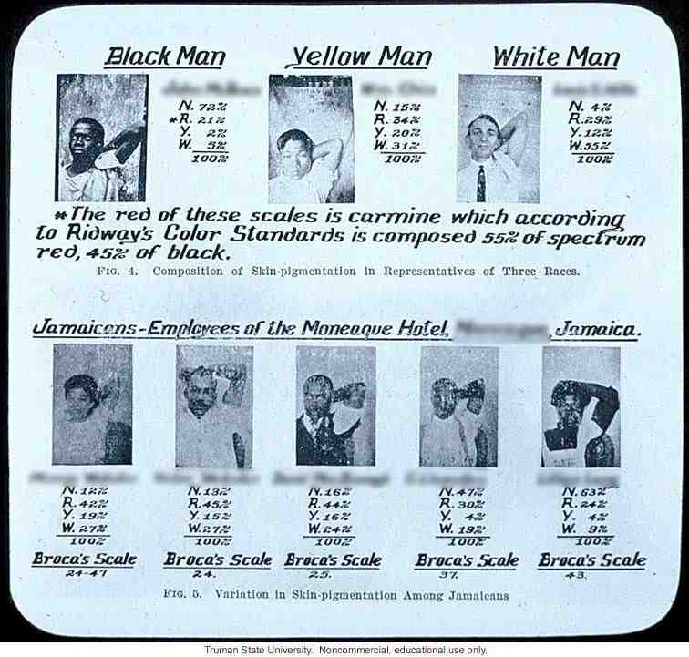
http://www.nyu-apastudies.org/2012/wp-content/uploads/2014/08/xImage-2-web.jpg.pagespeed.ic.dGntecRBzP.jpg

Slide 5
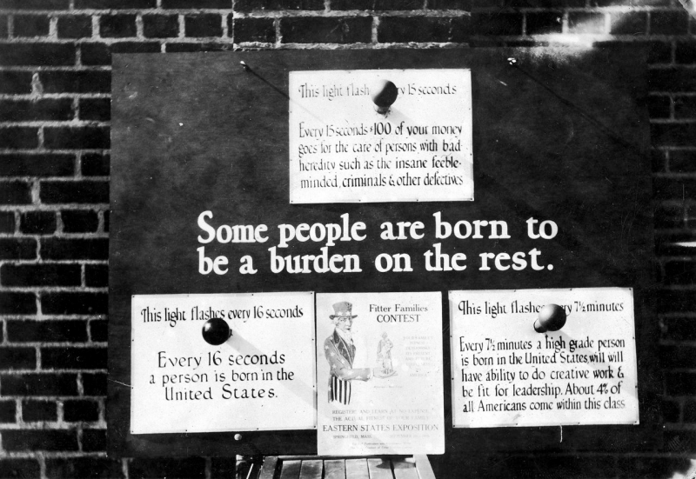
http://www.nyu-apastudies.org/2012/wp-content/uploads/2012/08/Burden-Low-res-APS-800x551.png

Slide 6
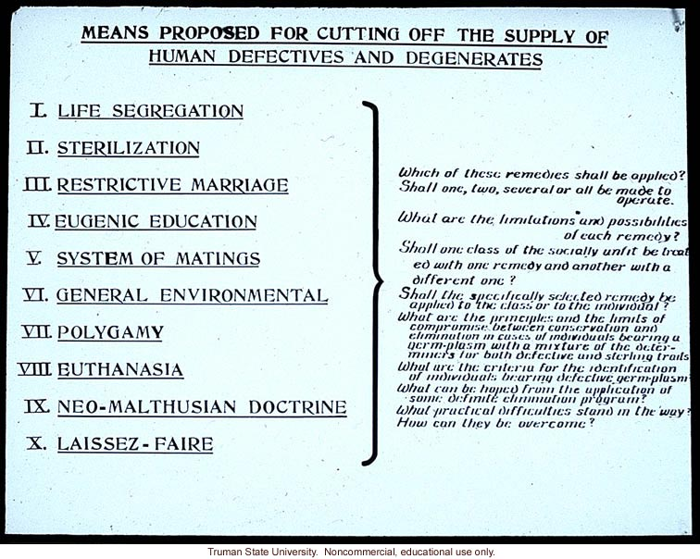
Source:http://www.eugenicsarchive.org/eugenics/view_image.pl?id=978

Slide 7
UNETHICAL CONDUCT
OF RESEARCH
Tuskegee Syphilis Study (1932 – 1972)
Guatemala STD Experiments ( 1946 – 1948)
Nazi Experiments: WWII (1939 – 1945)
Jewish Chronic Disease Study (1963)

Slide 8
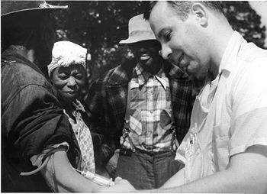
Tuskegee Syphilis Study
(1932 – 1972)
U.S. Public Health Service
“Natural history” of syphilis
600 low income African Americans
Thought they were getting free medical care
Treatment with penicillin standard in 1940s
Treatment withheld
Resulted in Belmont report

Slide 9
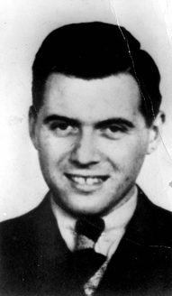
Nazi Experiments: WWII
(1939 – 1945)
Jewish, Roma, POWs, disabled
Eye color in twins
Sewing twins together
Bone, muscle, nerve transplants
Freezing experiments
Sea water experiments
Sterilization experiments
Resulted in Nuremberg code

Slide 10

Guatemala STD Experiments
( 1946 – 1948)
"Ethically Impossible" STD Research in Guatemala from 1946 to 1948 (2011 Report)
Soldiers, prostitutes, prisoners and mental patients intentionally infected with STDs.
No informed consent.
Subjects then treated with antibiotics.
> 80 deaths.
Discovered 2005.
Apology in 2010.

Slide 11
Jewish Chronic Disease Study (1963)
Brooklyn, NY
Injection of live cancer cells into patients hospitalized with chronic diseases
No consultation with patient doctors
No ethics review
No discussion on the injection of cancer cells
Consent not documented

Slide 12
Regulatory/ethical consequences from Unethical Research
Nuremberg Code (1948)
Declaration of Helsinki (1964)
Creation of NIH OPRR leading to IRBs (1966)
National Research Act – NCPHS (1974)
Belmont Report (1978)
Common Rule (1991)

Slide 13
Nuremberg Code (1948)
Voluntary
Good science
Prior knowledge – animal data first
Minimize risk
No expectation of death or disabling injury
Risk should not exceed future benefit
Proper preparation and facilities
Qualified staff
Free to withdraw
Investigator to end study if safety concerns

Slide 14
Declaration of Helsinki
(1964)
World Medical Association
6 revisions
Focus on medical community
Further developed Nuremberg code
Set standard for clinical research
Addresses placebo studies
Moral but not legal

Slide 15
Modern System
Creation of NIH OPRR leading to IRBs (1966):
Office for the Protection of Research Risks
“Society can no longer afford to leave the balancing of individual rights against scientific progress to the scientific community.”
1973 Report on the Tuskegee Syphilis Study

Slide 16
Modern System
National Research Act – NCPHS (1974): National Commission for the Protection of Human Subjects of Biomedical and Behavioral Research
Issued Belmont Report (1978)

Slide 17
Belmont Report
1. Autonomy (Respect for the person)
2. Beneficence (Do Good)
- Non-malfeasance (Do No Harm)
3. Justice
Common Rule (1991): Regulations defining current IRB system.

Slide 18
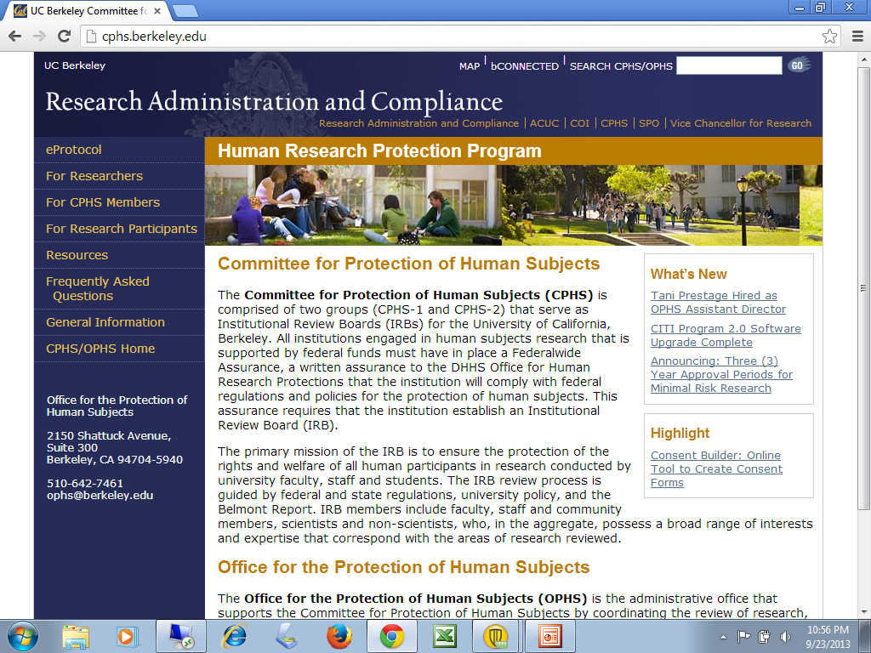
Institutional Review Board (IRB)
Protect the rights & welfare of human subjects
Support the University’s research mission
Review conduct of research guided by the principles set forth in The Belmont Report:
  Respect for persons
  Beneficence
  Justice
http://www.hhs.gov/ohrp/index.html
CPHS Human Subject Training:
http://cphs.berkeley.edu/training.html
Notes:
18

Slide 19
Case
Studies

Slide 20
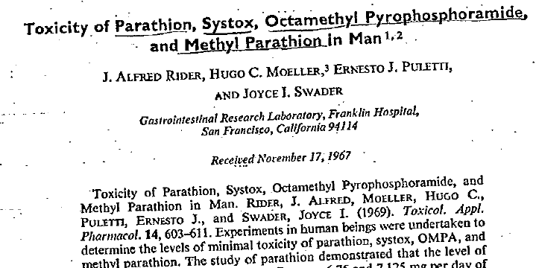
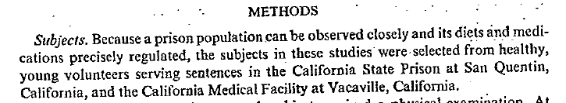


Slide 21
Toxicological Profile for Parathion
Draft for Public Comment
Ok to use this study for setting modern exposure standards?
A. Yes
B. No
Today, must include a statement such as:
All procedures were reviewed and approved by the UC Berkeley CPHS. Written informed consent was obtained from each participant.

Slide 22
My Comment:
Given recent controversies over the use of human dosing studies in pesticide registration, a section reviewing the ethics of pesticide human dosing studies should be included, and whether the studies reviewed and/or used for the establishment of the MRLs would meet modern standards, and, if not, justification on use of the information.

Slide 23
Response:
..the information that is provided about the participants being volunteers suggests that there is no clear and convincing evidence that the conduct of this study was fundamentally unethical.

Slide 24
Response:
Any human dosing study must have a useful purpose and convey a benefit to participants and/or society (NRC, 2004). ATSDR believes that the Rider et al. (1969) study provides a benefit to society in that the data provide the basis for a health guidance value (i.e., MRL) that can be used to protect exposed populations to parathion.

Slide 25
Toxicological Profile for Parathion
Draft for Public Comment
Ok to use this study for setting modern exposure standards?
Anyone change your mind?

Slide 26
Human Dosing Studies

Slide 27
Food Quality Protection Act (1996) added safety factor for children:
RfD=NOAEL/UF
UF = 10 X 10 x MF_{children}
10=Inter-species extrapolation
10=Intra-human variability
Modifying factor=No information on susceptibility of children=10

Slide 28
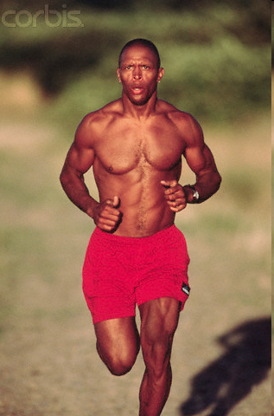
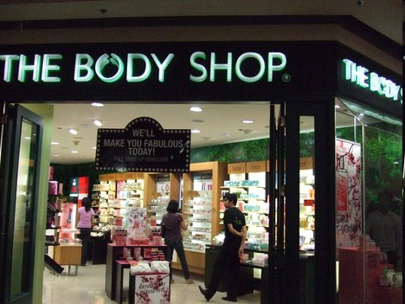
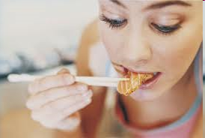
What is Toxicology?
Toxicology is the study of the adverse physiologic effects of chemical, physical or biological agents on living organisms, including the prevention and treatment of such adverse effects.
Are the O₃ levels too high today to jog?
Am I eating too much mercury this week?
Does this body lotion contain parabens?

Slide 29

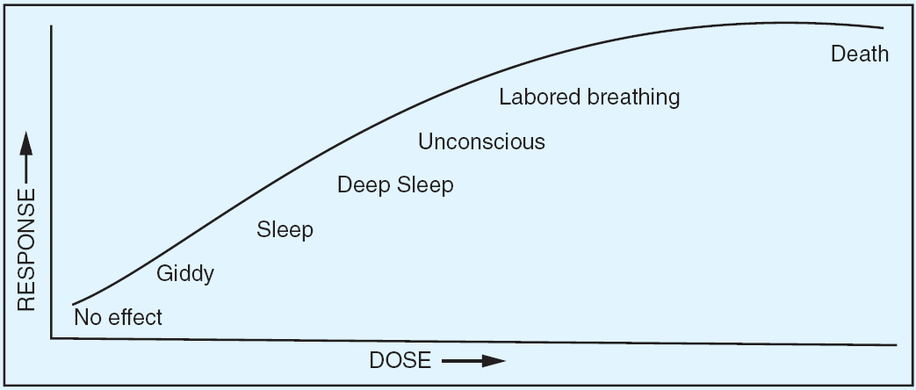
Dose-Effect Curves
Conceptually: An individual dose–response curve

Slide 30
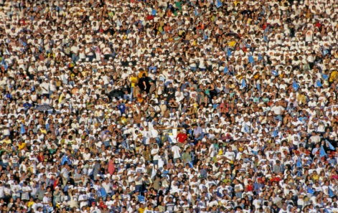
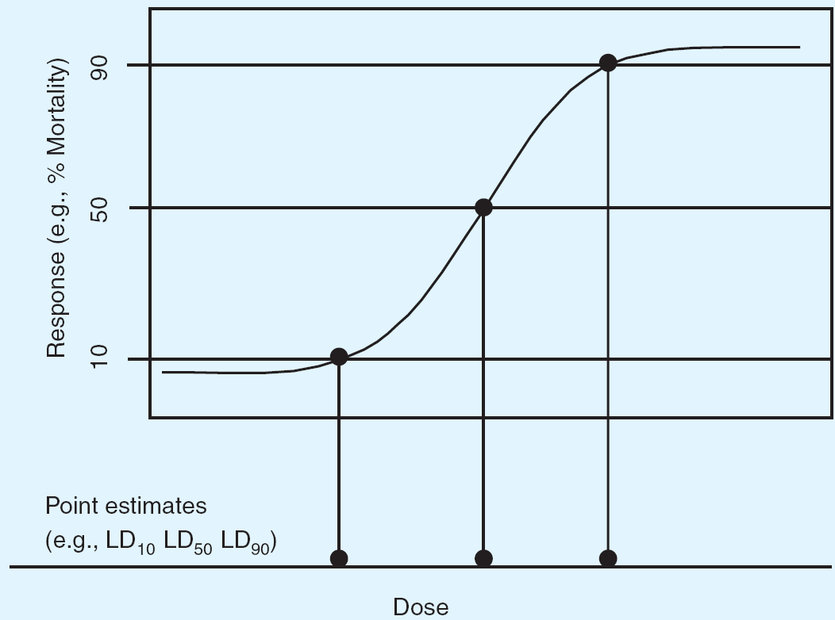
Dose-Response Curves
Population dose–response curve

Slide 31
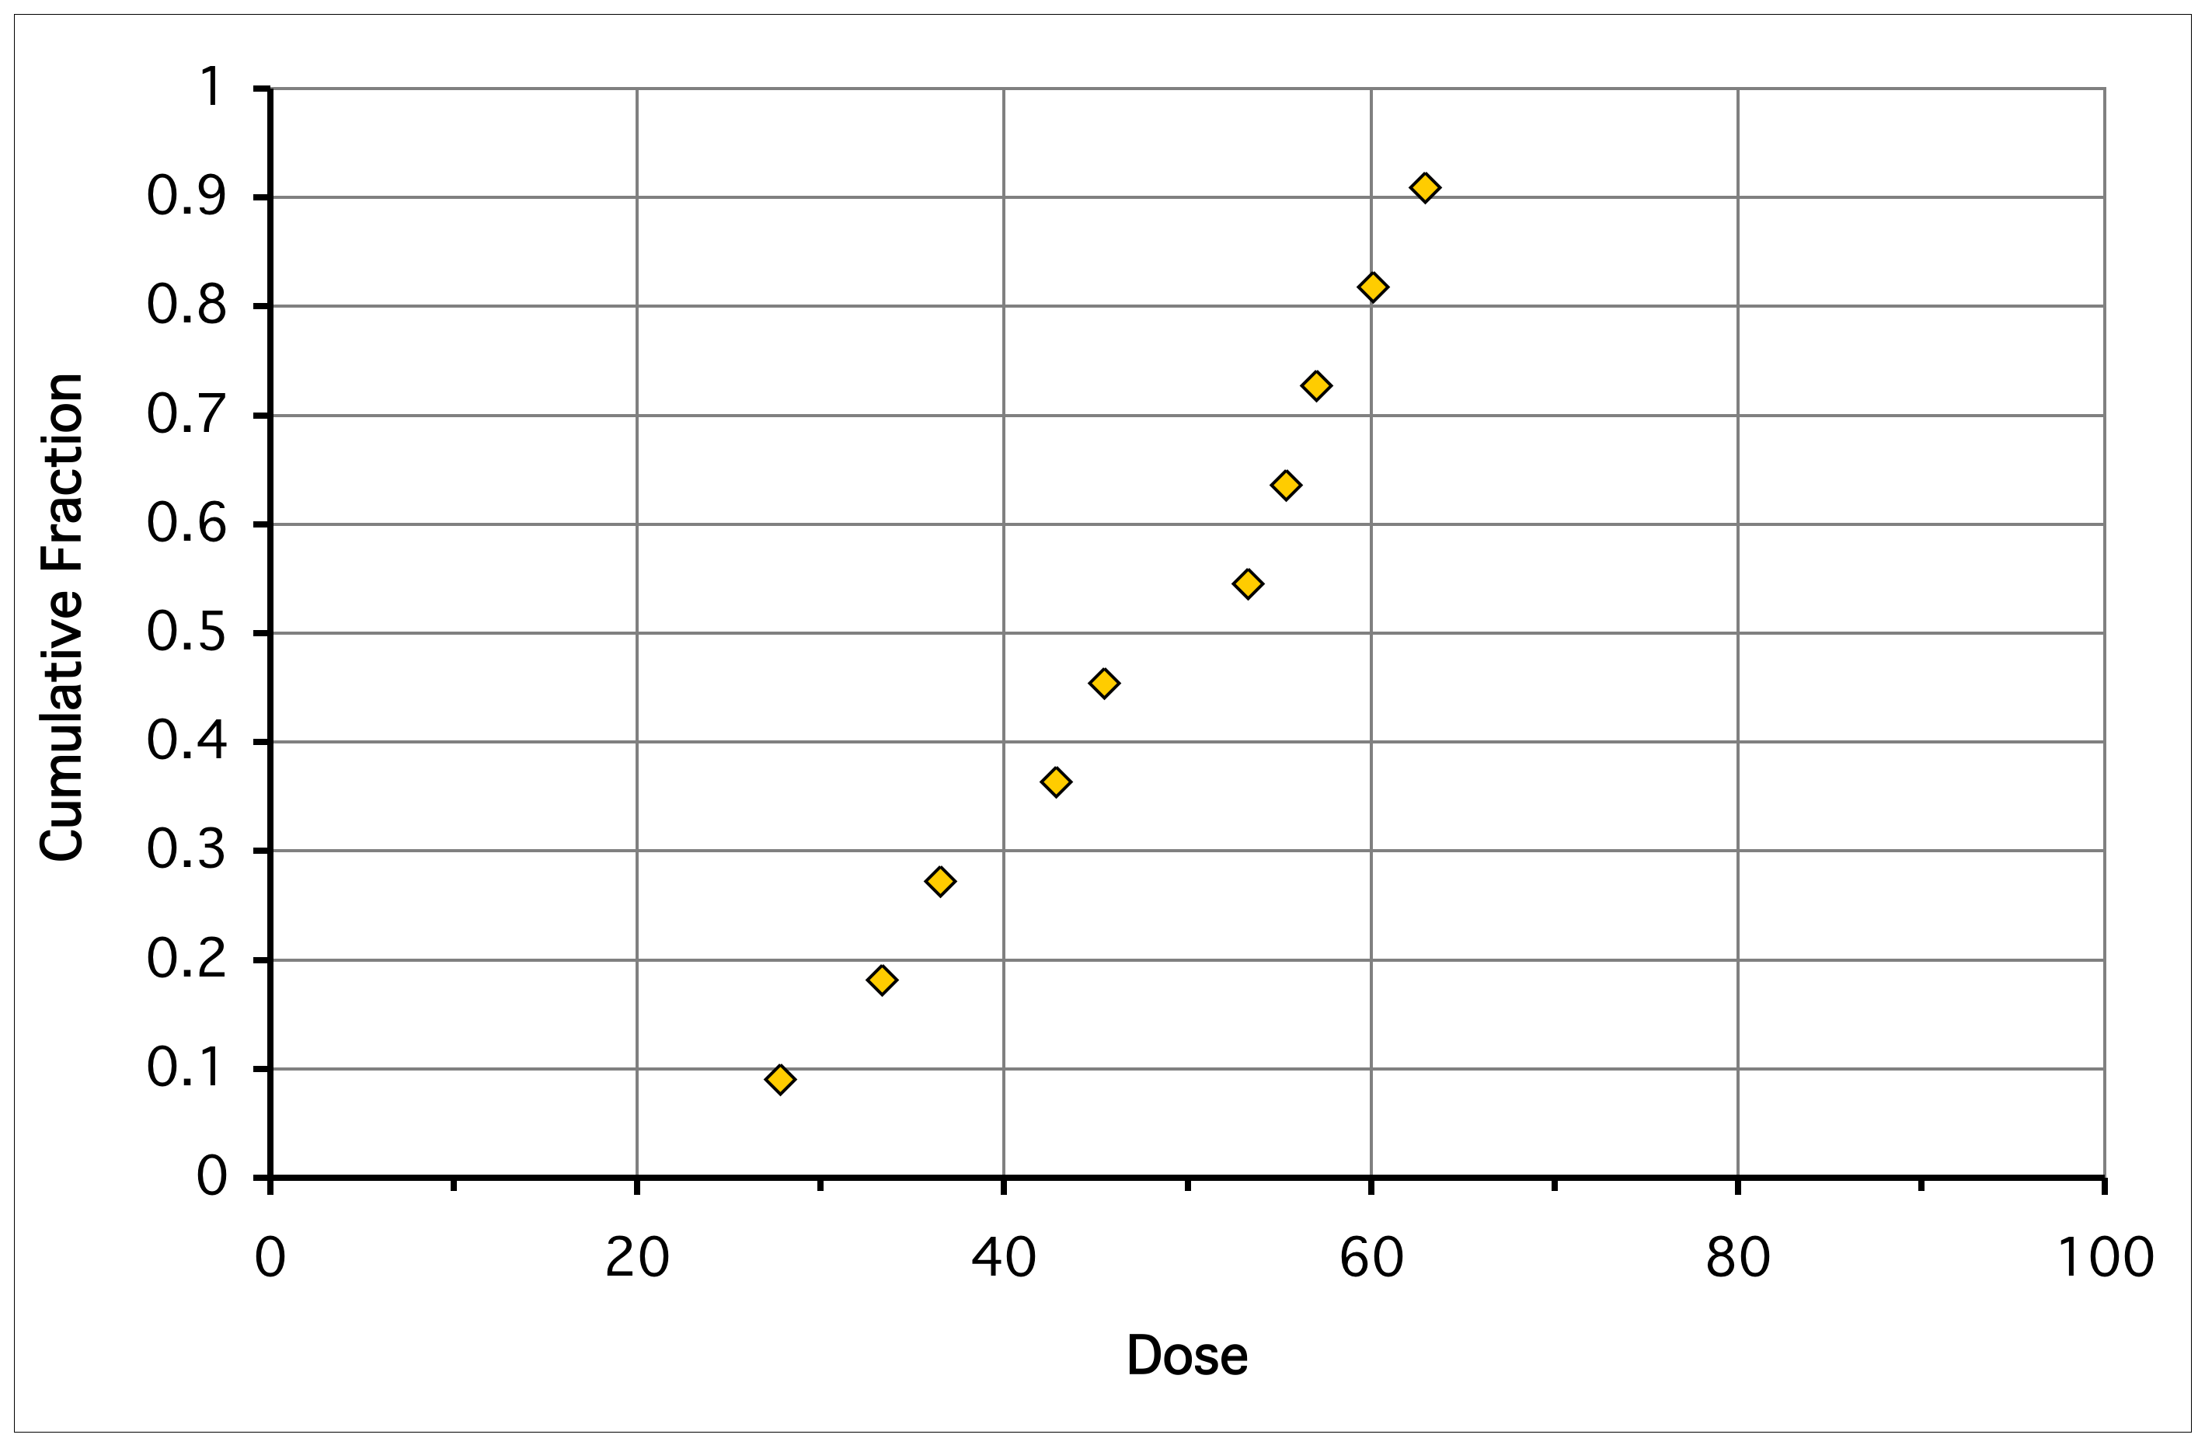
Dose-Response Plot for these Mice
Likelihood of effect at low dose?

Slide 32
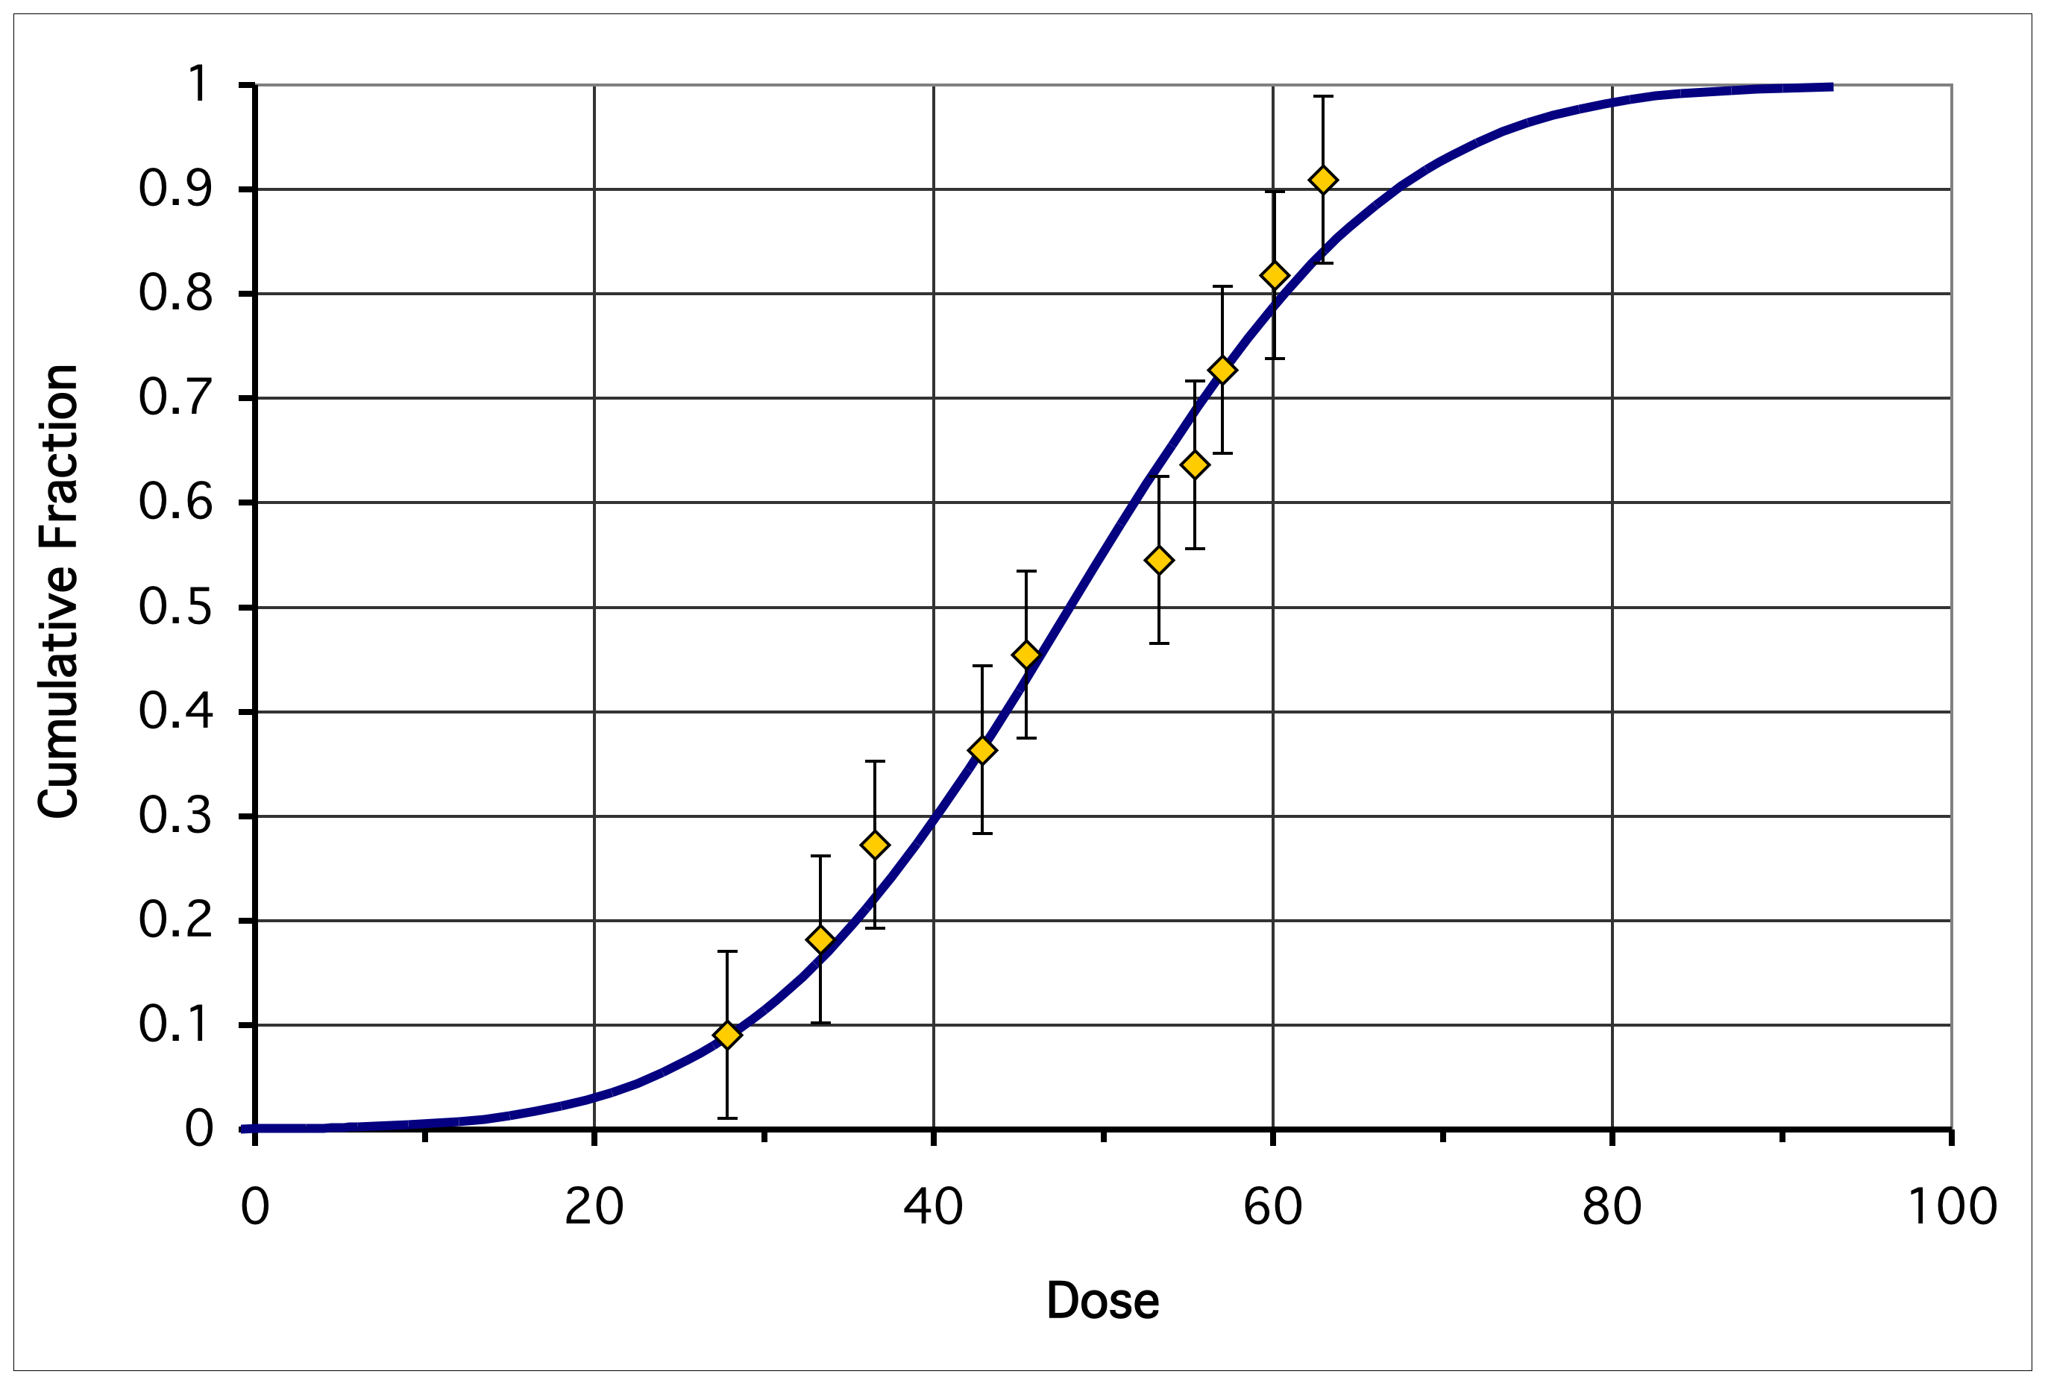
Dose Response Model
Safe dose? Likelihood of effect at low dose?
LOAEL (lowest observed adverse effect level)
NOAEL (no observed adverse effect level)
TD50 or LD50
Low-dose region

Slide 33
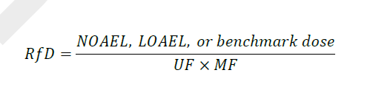
Non-Cancer Risk Assessment
Reference Dose (RfD)
an estimate of the daily acute or chronic exposure … that is likely to be without risk of adverse effects
UF=Uncertainty Factor (100-10,000)
10=Interspecies extrapolation
10=Variability within human population
10=Using less than chronic data
10=Using LOAEL instead of NOAEL
MF=Modifying Factor (no information for children) (1-10)

Slide 34
Non-Cancer Risk Assessment
Reference Dose (RfD)
an estimate of the daily acute or chronic exposure … that is likely to be without risk of adverse effects
  RfD = NOAEL/UFxMF
UF=Uncertainty Factor (100-10,000)
10=Interspecies extrapolation
10=Variability within human population
10=Using less than chronic data
10=Using LOAEL instead of NOAEL
MF=Modifying Factor (Ex: children) (1-10)

Slide 35
What happens if no intra-species extrapolation factor?
Example: Assume NOAEL=1 mg/kg-day
RfD= _________1_______ = 0.001
10_{sp} x 10_{var} x 10_{child}
RfD= _________1_______ = 0.01 (10x higher!)
10_{var} x 10_{child}

Slide 36
Food Quality Protection Act (1996) added safety factor for children:
RfD=NOAEL/UF
UF = 10 X 10 x MF_{children}
10=Inter-species extrapolation
10=Intra-human variability
Modifying factor=No information on susceptibility of children=10

Slide 37
Human Dosing Studies
By removing the factor of 10 for intra-species extrapolation, reduce uncertainty factor and increase RfD

Slide 38
Basic Committee Recommendations
The study is necessary and scientifically valid—cannot be answered with animal or other stuies
The societal benefits of the study outweigh any anticipated risks.
Reasonable certainty that no adverse effects.
All of the recognized ethical standards are observed.

Slide 40
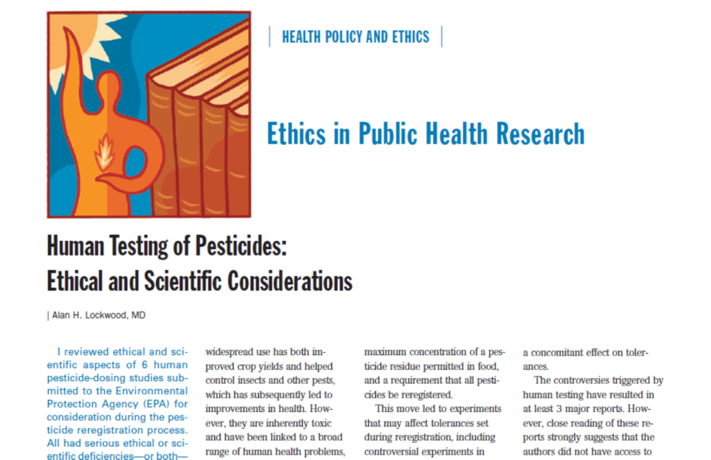
Lockwood Review
Reviewed 6 studies
Do not meet criteria
Concerns:
  Scientific validity
  Experimental design
  Generalizability
  Consent
  Adherence to standards

Slide 41
US EPA
All pesticide research using human subjects must meet our strict protective standards before we would consider using them in evaluating pesticides:
We have strong standards and high ethical protections for adults who voluntarily participate in intentional exposure studies for pesticides.
EPA's rules make it clear that all
  pregnant women
  all nursing women
  all children
  anyone who cannot provide consent
are banned from all studies involving intentional exposure to pesticides.
https://www.epa.gov/pesticide-advisory-committees-and-regulatory-partners/protections-subjects-human-research-pesticides

Slide 42
Is any human dosing study on an environmental contaminant ethical? (Exclude pharmaceuticals)
Yes
No

Slide 43
Belmont Report
1. Autonomy (Respect for the person)
2. Beneficence (Do Good)
- Non-malfeasance (Do No Harm)
3. Justice
Common Rule (1991): Regulations defining current IRB system.

Slide 44
Critique of Belmont Report
Operates at individual level.
Fails to address needs of communities:
  Environmental Justice
  Community-based research
Nancy Shore (2006)
Notes:
44

Slide 45
Community Interpretation of the Belmont Principles: Respect for Persons
Valuing different experiences within the research partnership
Creating a participatory process where all partners have a voice in decision-making
Translating findings into actual community benefits
Acknowledging multiple meanings of respect
Accounting for community-level consent
Shore (2006)

Slide 46
Community Interpretation of the
Belmont Principles: Justice
Creating an equitable research partnership
Challenging unjust structural problems
  “Justice really is not about helping people; it is about changing the social conditions that cause them to need help to begin with”
Shore (2006)

Slide 47
Community Interpretation of the
Belmont Principles: Beneficence
  Strengthening the community’s ability to address identified concerns
  Leveraging resources
  Building capacity
  Translating findings into action “If our research does not help the community organizations that we’re working with improve the condition that brought them to us, then we haven’t done our jobs…”
Shore (2006)

Slide 48
Suggested Revisions to
Belmont Report
Research Ethics Reconsidered in the Context of Community-Engaged Research: Proposed Revisions to the Belmont Report and Federal
Regulations Guiding the Protection of Research Participants
https://ccph.memberclicks.net/assets/Documents/PapersReports/research_ethics_reconsidered_final.pdf

Slide 49

Center for Health Assessment of Mothers And Children Of Salinas
A community-university partnership
Notes:
CHAMACOS means children in Mexican Spanish
CHAMACOS is a Community - Univeristy partnership

Slide 50
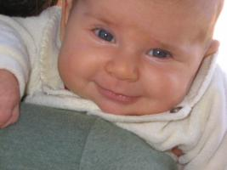
Children are more exposed and vulnerable to toxicants:
Higher exposures:
  Frequent contact with the ground or floor
  Hand-to-mouth activity
  Less varied diet
  Eat, drink, and breathe more per kg
  Spend most of their time indoors
Notes:
Providing an environment where this is safe and healthy to explore will stimulate a child’s natural curiosity and establish foundations for optimal learning in the future.

Slide 51
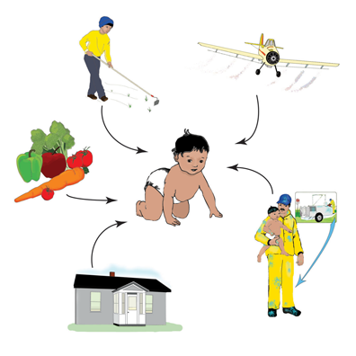
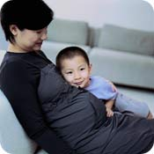
Exposure Routes
Ingestion
Inhalation
Dermal
Across the placenta

Slide 52
Selevan, SG et al. Identifying Critical Windows of Exposure for Children’s Health.
EHP 2000;108 Suppl 3:451-455

Slide 53
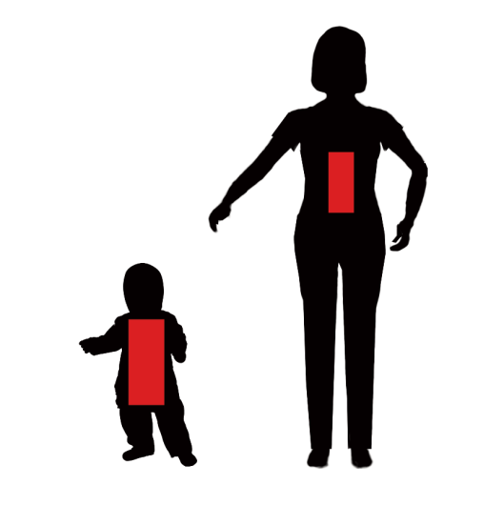

Slide 54
Organophosphate Pesticide Levels in U.S. Population
6-11years old: 113 nm/L
12-19 yearsold: 93 nm/L
20+ years: 75 nm/L
Barr et al, 2005

Slide 55

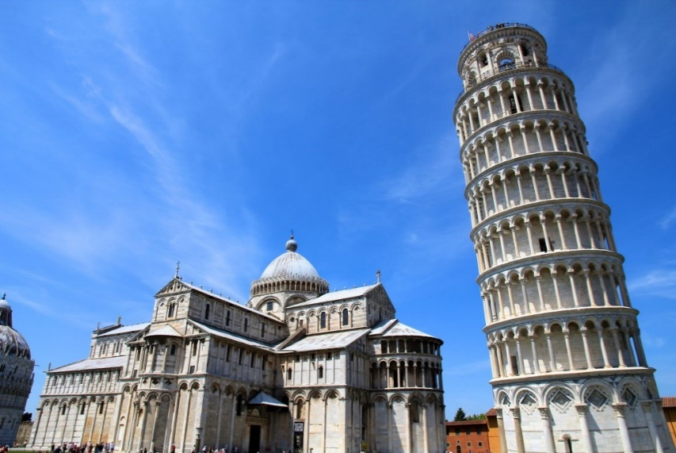
Children are more exposed and vulnerable to toxicants:
Metabolism
  Metabolic pathways undeveloped
Developmentally immature
  Neural architecture not yet in place
Notes:
Providing an environment where this is safe and healthy to explore will stimulate a child’s natural curiosity and establish foundations for optimal learning in the future.

Slide 56
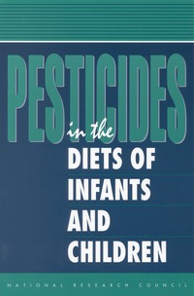
Food Quality Protection Act of 1996
Charged U.S. EPA to determine safe levels of pesticide residues in food:
  must consider specific vulnerabilities of children
NRC, 1993

Slide 57

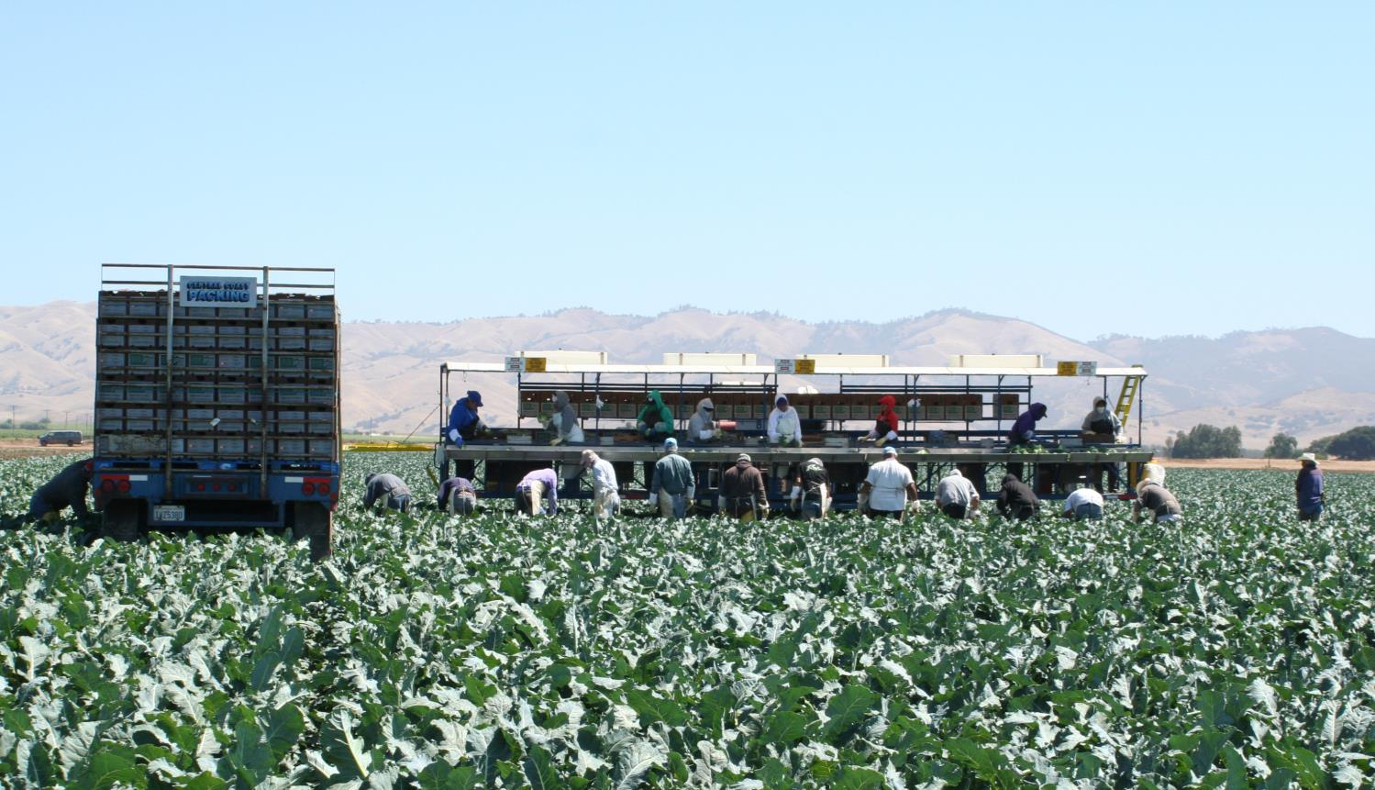

Salinas Valley
The “Salad Bowl” of the Nation

Slide 58
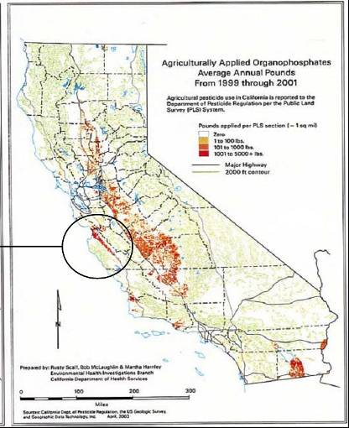
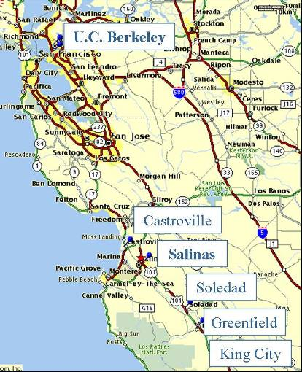
CHAMACOS Study Area
Notes:
the Salinas Valley is an agricultural area ~100 miles south of SF commonly referred to as “the salad bowl” of America
Salad crops (lettuce, spinach, tomatoes, broccoli, celery), strawberries, artichokes

Slide 59
Establishing a
Community-University Partnership
What are the principles of this partnership?
Who represents the community?
What is the role of the community in the partnership?
What are the researchers’ obligations to the community?
Notes:
We had to find who we were going to partner with.

Slide 60
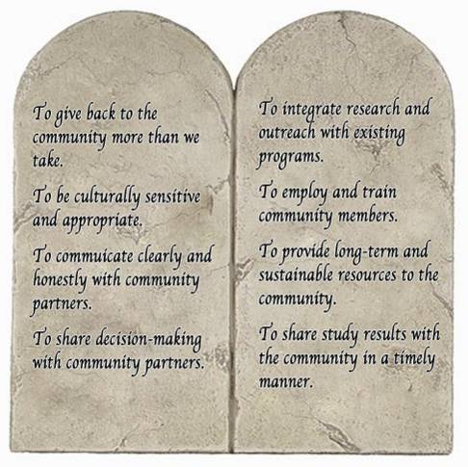
Establishing Principles and Guidelines
Our Commandments
Notes:
Researchers at UC Berkeley developed these principles to guide the research,
This is what we strive for.
PAUSE, let people read it…
3) While there are all important, the first one captures the essence of the commandments.
-Point out first one on each list.

Slide 61
Establishing a
Community-University Partnership
What are the principles of this partnership?
Who represents the community?
What is the role of the community in the partnership?
What are the researchers’ obligations to the community?
Notes:
We had to find who we were going to partner with.

Slide 62
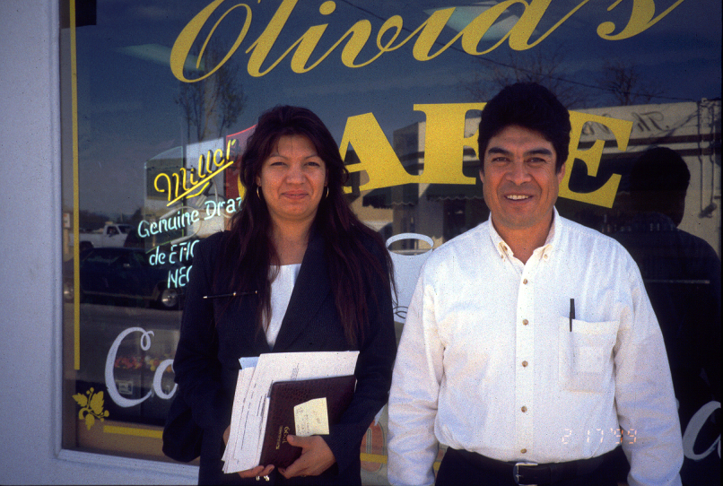
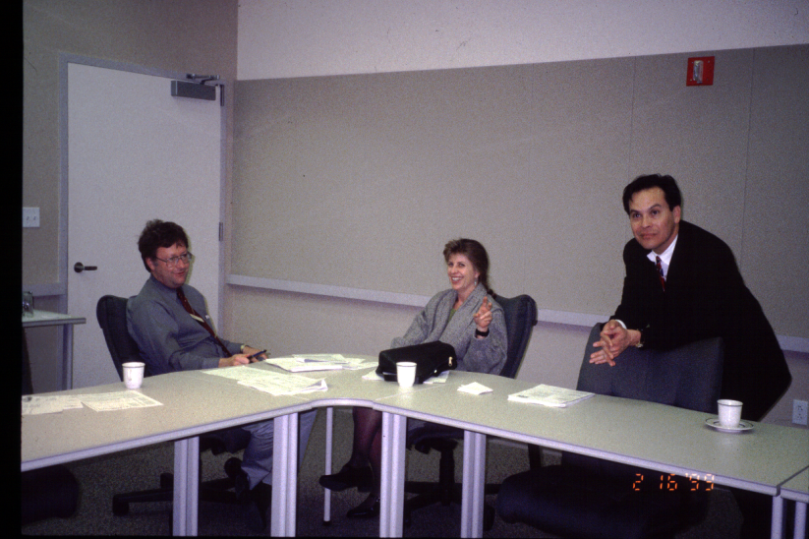
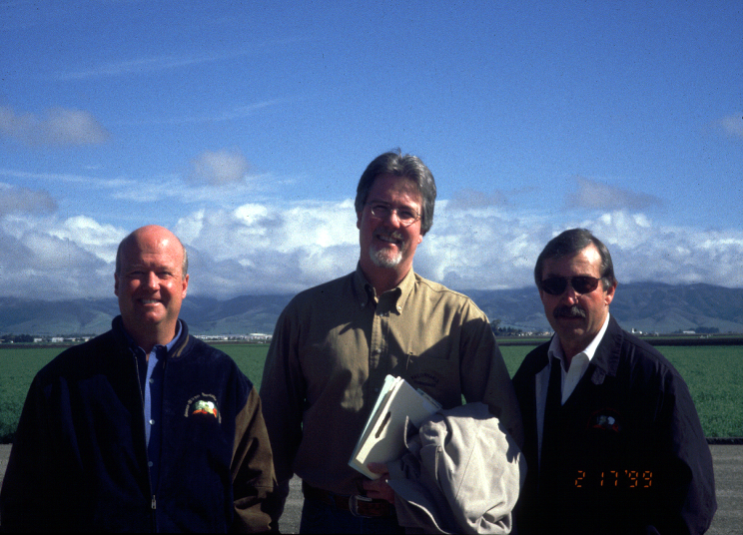
Key Community Leaders
Jesus Lopez (right), a member of a social service collaborative serving farmworkers
Dr. Max Cuevas (right), Executive Director of the local clinics network
Jim Bogart (left), Executive Director of the Grower-Shipper Association
Notes:
We had contacts from the UC Ag-Extension, and from there we asked people “Who should we be talking to?”
It was important for us to include everyone who has a vested interest in the study, including growers

Slide 63
Establishing a
Community-University Partnership
What are the principles of this partnership?
Who represents the community?
What is the role of the community in the partnership?
What are the researcher’s obligations to the community?
Notes:
Together, with our community partners we decided what the role would be of community input.

Slide 64
CHAMACOS
Advisory Structure
Scientific
Advisory
Board
Youth
Community
Council
CAB
Farmworker
Council
Growers
Council
Community Advisory Board
Notes:
22
To communicate with our community partners, we have a systems of boards and councils, then principal council being the CAB. Diverse group political
CAB meets once a year to update on findings and receive input on future research, also review scientific papers before publication
We have Farmworkers Council and Growers Council to have safe places where each constituency can discuss their concerns in a more open manner. Conducted in spanish.
Youth Council (which we will be inviting a member to sit on this year) because now that the children are 12, we felt it was important for them to have representation in some form. The hope is to include YCC member in the CAB.
Scientific advisory board guides scientific matters and future directions.
Growers Council: meets annually to discuss findings.

Slide 65
Establishing a
Community-University Partnership
What are the principles of this partnership?
Who represents the community?
What is the role of the community in the partnership?
What are the researcher’s obligations to the community?
Notes:
Together, with our community partners we decided what the role would be of community input.

Slide 66
Complex web of factors
Immediate environment
Enrichment
Larger environment
Other host factors
Health
Home
Environment
Genes
Nutrition
Violence
Pesticides
Discrimination
Housing
quality
Poverty
Acculturation
Family Relationships
Notes:
KP – You can keep this slide or make one of your own. I use this to say something like “Kim has told you about our findings that pesticides and other chemicals impact children’s health and development, but obviously, there are a lot of other factors to consider, particularly in this community”

Slide 67
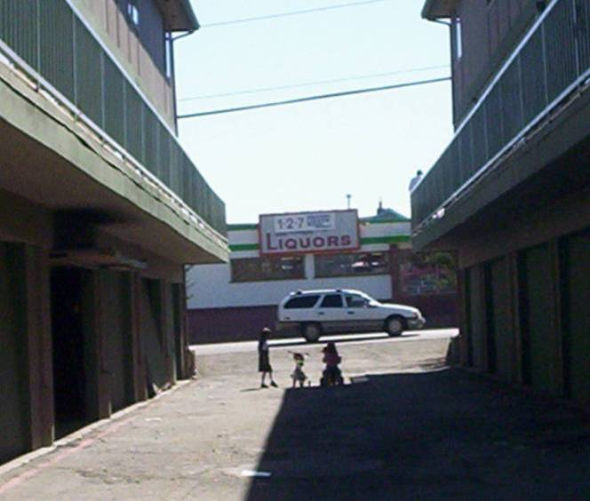
Notes:
Gang violence is a huge problem. 4th highest homicide rate in California.
23 gang-related killings in 2008.

Slide 68
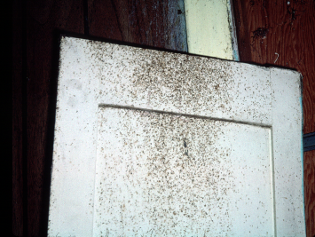
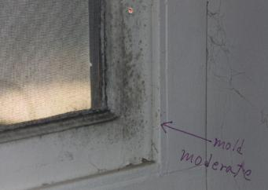
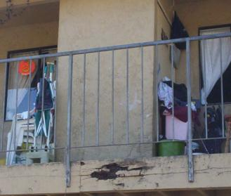
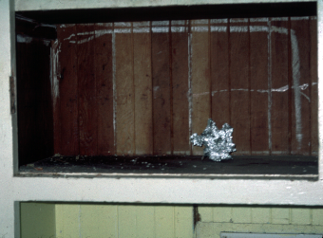
Housing Quality
Notes:
Will review some images of what we commonly see.

Slide 69
Household Food Insecurity
80
70
60
CHAMACOS
50
40
30
20
NHANES
10
Rosas et al., JADA, 2009
0

Slide 70
Our Ethical Obligation to the Participants
Referring kids to school district for learning disabilities
Referring moms and kids to mental health for depression
Housing quality referrals
Food banks
Other social services

Slide 71
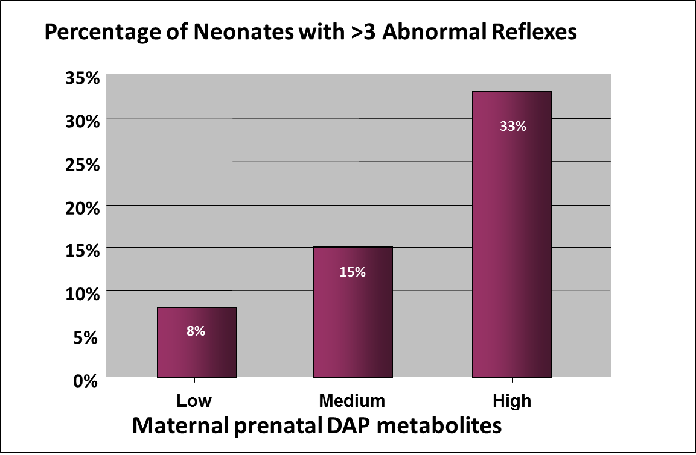
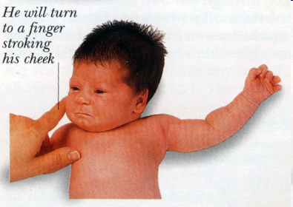
Prenatal OP metabolites related to abnormal reflexes in neonates (n=184)
Brazelton Neonatal Behavioral Assessment Scale
p_{trend} = 0.01
www.ababycare.com
Only cluster in 7
Young et al., Neurotoxicology 2005

Slide 72
And mothers’ OP metabolite levels were also related to child’s IQ at age 7
Bouchard et al, EHP (2011) 199(8): 1189-95
Notes:
7 point decrease between high and low – comparable to lead.
This means that the children in the high group are functioning as if they were 6 months younger than those in the low group.
Controlling for ….

Slide 73
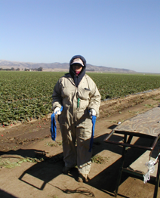
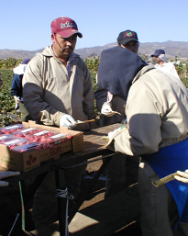
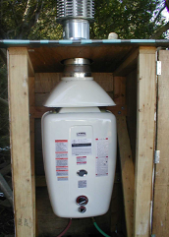
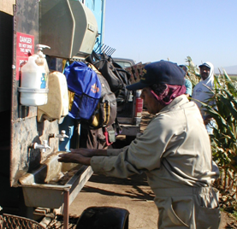
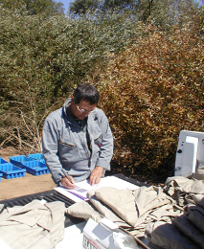
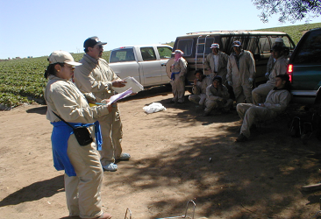
Technical Intervention: Methods
Developed method for providing warm water in the field.
Trained crew leaders to use system. Crew leaders filled tanks.
Gave gloves to crew leaders & ponchadoras.
Developed & provided lightweight coverall
5 field-based education sessions
At work drop-off, pick-up & laundering of coveralls
Notes:
Although time today does not permit me to discuss this intervention, I wanted to briefly present the intervention activities.

Slide 74
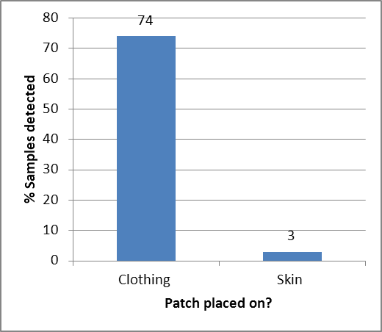
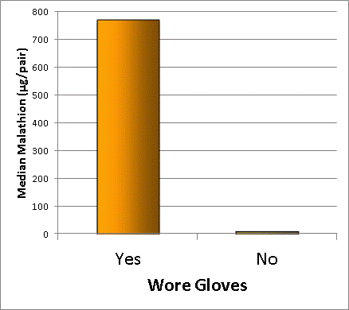
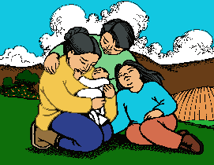
Clothing and gloves reduce levels of malathion on skin and hands
777
76
777
766
p-value <0.001
8
86
Clothing
Skin
No
Yes
Yes
Patch placed on?
Bradman et al. JESEE 2009

Slide 75
Workers who did not wear gloves had higher urinary pesticide levels
140
120
100
80
Median MDA (μg/g creatinine)
60
40
20
0
Yes
No
Wore Gloves?
Bradman et al., JESEE 2009

Slide 76
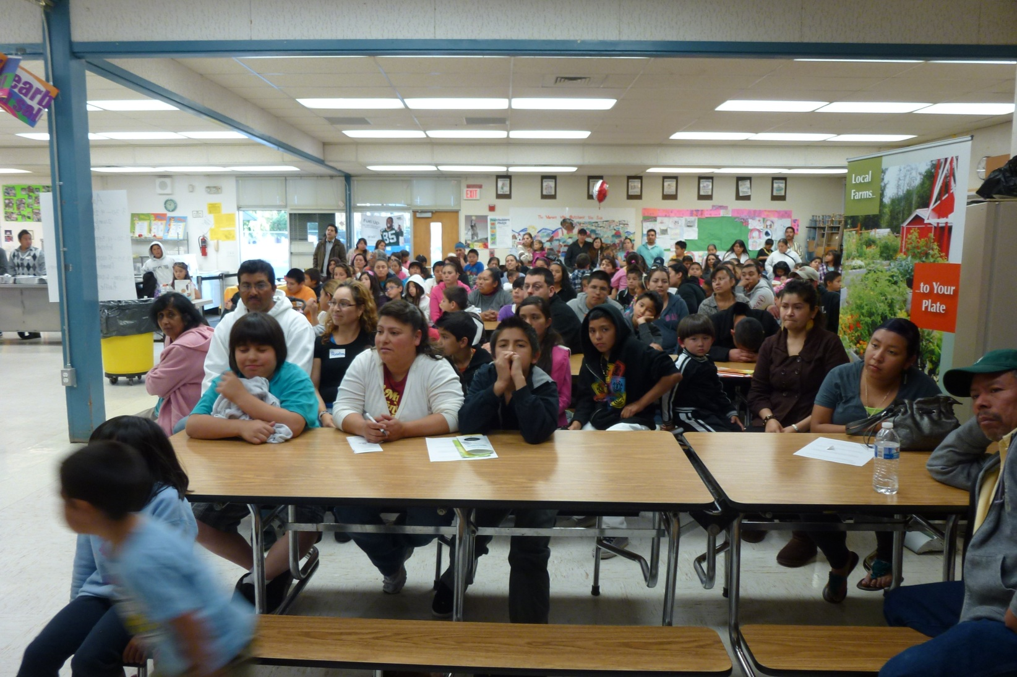
Sharing Research Findings with the Community
Recent study findings presented to participants
Notes:
In my opinion, our most important objective. To let participants and community members know about the study findings first. We don’t want the first time they learn this information to be when they hear it on the news.
We do this by having an annual community forum where have present the latest findings, but we make sure to have activities and food to make it interesting and engaging
These are unpublished findings. We keep them informed of what we are finding before we submit them for scientific publication.
Challenge to make it engaging and understandable.

Slide 77

Prenatal Environmental Health Kiosk for Pregnant Women
Notes:
77
The Prenatal Kiosk is a Low-literacy software, out loud, touchscreen, low thresh hold technology…. Available in English and Spanish, available on our website.
It’s a guide for pregnant women to learn about environmental health concerns in their food, in their homes, at work, and in the outside air.
Ends with Loteria, matching cards. women are given a rhyme to match the topic discussed.

Slide 78

Puppet Shows to Teach Environmental Health to Children
Notes:
A puppet show for children, to introduce to the idea of pesticides
Anecdote of parent who learned lesson from child, man said you are the reason my kids don’t hug me anymore. comes home with work clothes and child says don’t hug me. Jose asks is this a good thing? Man says yes. We want to foster conversations like this.

Slide 79


The CHAMACOS Youth Council
Educate youth on local environmental health challenges
Provide youth with the tools to create a healthier Salinas
Notes:
Two key goals, the first is to teach a group of high school students about environmental health
Provide young people with the tools to make positive changes in their community

Slide 80



Educating Policy Makers
Housing conditions and policies addressing rental units in Salinas
Organophosphate pesticides and neurodevelopment.
Agriculture Commissioner
Eric Lauritzen
Director, CDPR
Brian Leahy
Notes:
We have also met with elected officials to share study results
We are working to educate on flame retardants in California, we have also met with the Fire Dept.

Slide 81


Slide 82
You have a feeling that a child in your study may be abused. The family participating was assured confidentiality. Do you call Child Protective services?
Yes
No

Slide 83
You conduct a home visit for a research study looking at children’s environmental health. The child is well dressed and groomed. The home is in very bad condition – severe mold, rodent feces, garbage, overall bad housing quality. Does this rise to the category of neglect, one definition of child abuse?
Yes
No

Slide 84
You conduct a home visit for a research study looking at children’s environmental health. The child is well dressed and groomed. The home is in very bad condition – severe mold, rodent feces, garbage, overall bad housing quality. You see what look likes a firearm. Does this rise to the category of neglect, one definition of child abuse?
Yes
No

Slide 85

You supervise a study examining different strategies to reduce lead paint exposures to children: “The Lead Based Abatement & Repair Maintenance Study in Baltimore”
Is it ethical to test lead abatement methods when you know some kids are going to be exposed to lead? Do you need to tell the parents how they will be exposed?

Slide 86
Kennedy Krieger Study:
https://en.wikipedia.org/wiki/Baltimore_Lead_Paint_Study
Lead Paint Trial Castigated
http://www.sciencemag.org/news/2001/08/lead-paint-trial-castigated

Slide 87
https://www.ncbi.nlm.nih.gov/pmc/articles/PMC1470603/
We contend that the failure to conduct such research causes greater harm, because it deprives disadvantaged populations of the benefits of imminent incremental improvements in their health conditions.

Slide 88


The field of ethics is rich.
For more reading still, see:
http://www.niehs.nih.gov/research/resources/bioethics/bioethicist/

